Slide 1
2Ring Dashboards & Wallboards ..
Business User Friendly Real-Time Reporting & Alerting
for all Cisco Contact Center Platforms ..
Product Owner Contact: Micha(e)l Grebac
Email/Webex: mgrebac@2Ring.com
Follow Us on Twitter: @2RingCX | @MichalGrebac
Learn More: 2Ring.com/WebexCC
Last Refresh: January 12, 2024

Slide 2
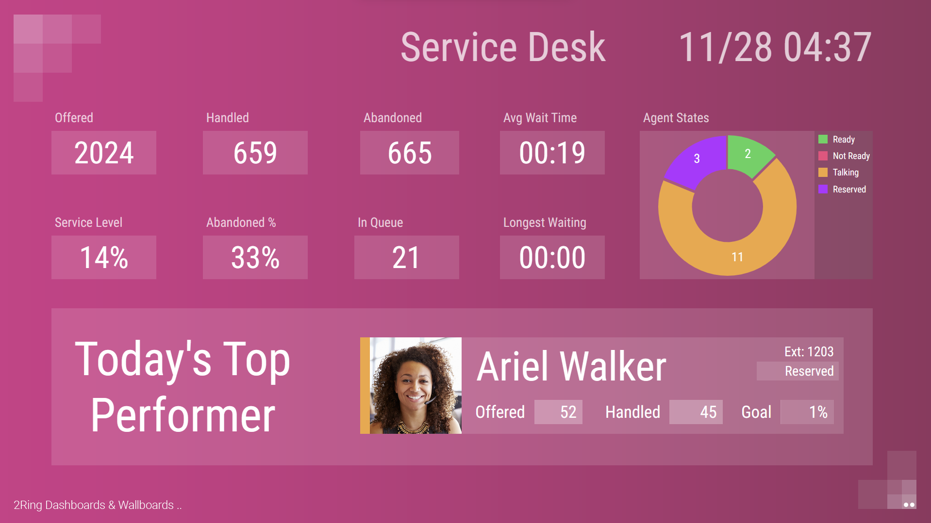
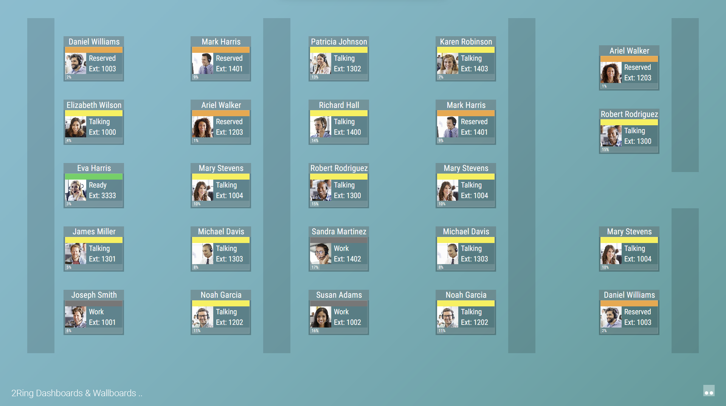
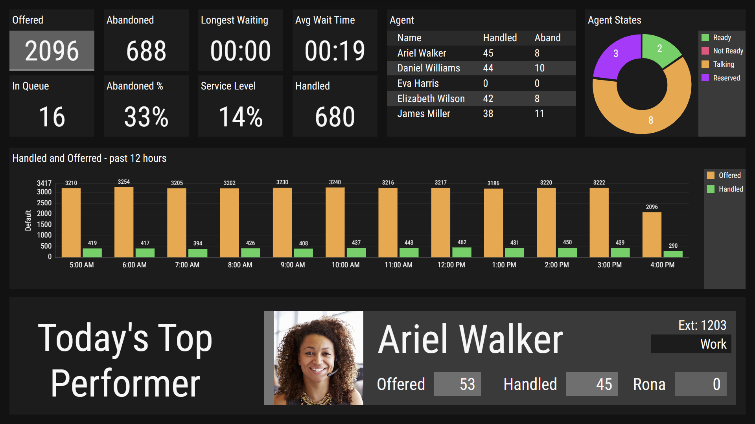
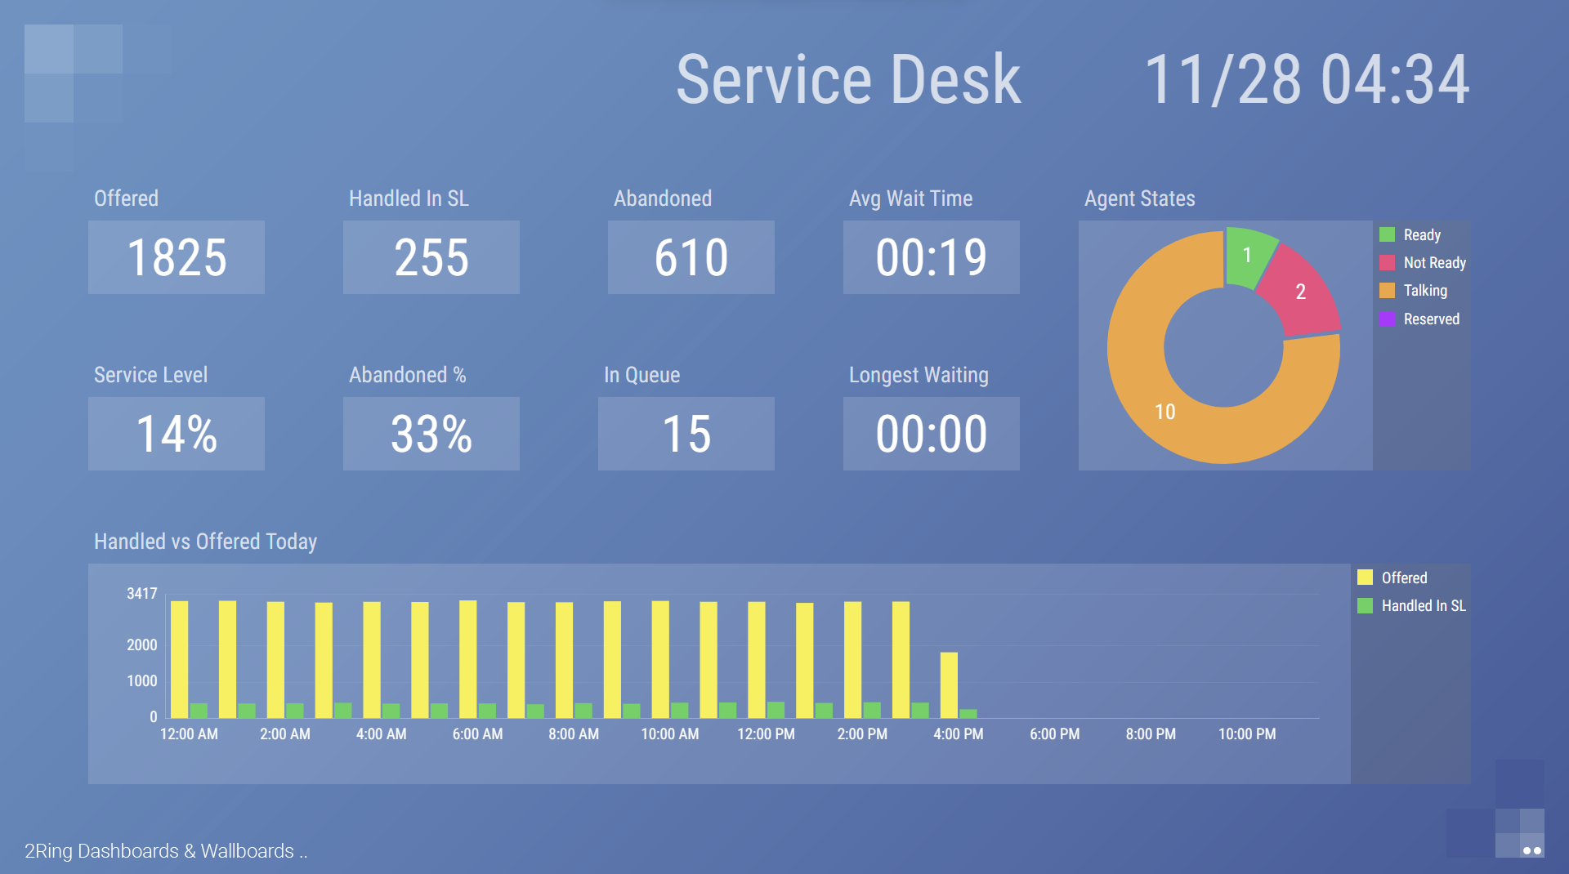
Deliver Eye-Catching & Flexible Layouts ..
Notes:
2Ring empowers customers to use their data to build a mix of many views, so to create different views depending who the target audience is and then also bring these layouts to this audience to where they are – embed these into WebexCC agent or supervisor desktop, or displayed personalized views next to or on top of the CRM system that agents work with, or embed these views into webex or Microsoft Teams, or just setup thresholds and alerts to deliver notifications if thresholds are breached.

Slide 3
Business Case for 2Ring Dashboards & Wallboards ..
Deliver Data to Where your Users are
Compatible with all major browsers
Keyboard less secure sign-in on TVs or signage devices
Embed layouts into WebexCC Agent and Supervisor Desktop, or display a personalized layout next to Salesforce UI (split tab feature in MS Edge), or make a layout float on top of all the application windows (2Ring Power Tool)
Add layouts into a space in Webex, or to a channel in Microsoft Teams (bring real-time visibility to users who are not part of the contact center)
Include a link to a specific layout with any of your real-time alerts sent via email, text message, or to your corporate IM client
Merge Multiple Data Sources
Show ServiceNow Data next to WebexCC data
Massage Data with Ease (slick & easy to use)
Break-down stats for different skill-groups, sites, ..
Merge data for multiple queues / skill groups into one row / KPI
Create your own CUSTOM calculations using derived metrics
Create floor plans by leveraging powerful widgets
Encourage Competition Among Teams and Agents
Upload personalized targets for agents or teams (csv import)
Showcase best performers – e.g. top agents or teams
Use calendars to visualize how well, or how often a goal was met
Show trends – e.g. # of calls handled over the last 4 weeks
Send encouraging messages to a scrolling text marquee

Slide 4
Let’s Make a Few Things Clear ..
How to Quote / Order
All SKUs through Cisco, via CCW / Ecommerce
2Ring Reseller Agreement is not required
Public Demo Cloud
Request Access at 2Ring.com/DWWebexCCtrial
To get your own NFR Tenant from 2Ring or to get your own Business Unit in our public cloud environment, please contact us.
Instant Sample Layouts
2Ring.com/TryItWXCC
2Ring.com/TryItWXCCgrids
Supported Cisco Platforms
Cisco Webex Contact Center
Cisco Webex Contact Center Enterprise*
UCCX – Express*
UCCE – Enterprise*
PCCE – Packaged*
* Self-Hosted Subscription Only
How to Consume 2Ring
2Ring Cloud Subscription – 2Ring-SaaS
2Ring Self-Hosted Subscription – 2Ring-SB
Notes:
2Ring works with all Cisco contact center platforms – the only difference is that customers with WebexCC are able to use 2Ring Dashboards & Wallboards from 2Ring Cloud or they can choose to self-host it, but those customers who are on UCCX/UCCE/PCCE or WebexCC Enterprise, these customers will need to self-host 2Ring – they do not have the option to use our 2Ring Cloud service.

Slide 5
Procurement .. Purchasing 2Ring DW
2Ring Dashboards & Wallboards (2Ring DW) is available via Cisco Ecommerce: www.cisco.com/go/ordering
Step 1
Step 2
Step 3
PID | Description
2RING-SAAS | 2Ring Cloud Subscription
2RC-DW-WXCC | 2Ring DW - WebexCC - per concurrent agent/supervisor
2RC-DW-CRD | 2Ring DW - WebexCC - per conc agent/supervisor – migration
2RING-SB | 2Ring Self-Hosted Subscription
2RS-DW | 2Ring DW – per concurrent agent/supervisor
2RS-DW-CRD | 2Ring DW – per concurrent agent/supervisor – migration
2RING-1TF | One-Time Activation Fees
2RC-SERVICES | Setup, and training – CLOUD
2RS-SERVICES | Setup, and training – SELF-HOSTED
2Ring Cloud (2Ring-SaaS)
or
2Ring Self-Hosted (2Ring-SB) Subscription
New Customer
or
Existing Customer moving from perpetual licenses
Identify
Number of Concurrent Agents (min 10) and initial term (min 12-months)
2RIng Cloud Subscription Ordering Example:
New Customer for 2Ring Cloud
PID | Term | Descriptions and Inclusions
2RC-DW-WXCC | 1 Year | 2Ring DW - Cisco WXCC Connector - per concurrent agent/supervisor
2RC-SERVICES | n/a | 2Ring Service Activation Fee (Cloud)
2Ring Terms
2Ring Cloud at www.2Ring.com/LegalCloud
2Ring Self-Hosted at www.2Ring.com/Legal

Slide 6
Support, Delivery, and Customer Success with 2Ring
2Ring offers an exceptional onboarding experience from introduction through to discovery, delivery, and ongoing customer satisfaction.
Delivery Timeline for 2Ring DW
Order’s hold released once basic information gets confirmed
Tenant available in 2-3 business days
Custom Layouts and Credentials Shared with Admin shortly after
Training videos on YouTube + Webex Session once requested
2Ring Cloud SLA
24 x 7 Customer Support
Reality: <1 hour avg. response time
Severity 1: less than 4 hours
Severity 2: less than 12 hours
Severity 3: less than 72 hours
Severity 4: less than 96 hours
Ensuring Customer Satisfaction
We train and equip customers to confidently adjust layouts and alerts on their own
Encourage feedback from customers and resellers to improve our offering
Our NPS is continuously over 90
Delivery Timeline
1st Week
2nd Week
3rd Week
4th Week
And beyond ..
Collect Initial Requirements
Tenant Creation + User Access
Finetune Layouts, Alerts, Themes
Training Videos + Session
24x7 Support from 2Ring ..

Slide 7
Proven by Hundreds of Customers Worldwide ..
2Ring has revolutionized our ability to easily communicate key metrics to our entire organization. It has proven to be a versatile tool that can easily tie back to data from our latest generation phone system as well as our legacy systems. Overall, we are extremely happy with its functionality and ease of use.
The support team have always been quick to assist with the task and followed up until resolution. They have also assisted me in learning a little bit with each ticket so I can eventually be self-sufficient. A big kudos to the technical support team.
.. our supervisors are often pulled in multiple directions at the same time. The 2Ring solution has given them greater visibility and therefore control over our queues and agent management.
When we first started looking for a real time reporting wallboard application, we had a fundamental requirement. The selected solution needed to provide meaningful live data to support our self-management efforts and track our KPI performance. In addition, the selected platform had to be supportable by our contact center team with little to no effort/support and/or burden on our IT/IS team. I’m happy to report that after several months of utilization we can say proudly that we selected the correct solution. If you want a top performing tool supported by a great team, 2Ring is the correct choice for your organization.
Our 2Ring solution is providing much needed visibility for both our affected employees and management. Seeing real-time queue and agent status has contributed to more awareness around the organization’s ability to handle incoming patient calls to appointment schedulers and business office representatives.
The service we have received from 2Ring has been great, they don't let go until a problem is resolved and you understand what happened. I would suggest their products and services to any HealthCare organization in the world.
We needed a true wallboard solution for our Contact Center. We needed an application that would not only allow for real-time statistics but would make the actual day to day management of the tool user friendly. We vetted multiple vendors, went through multiple demos, and ultimately landed on 2Ring. The combination of cost, licensing model, familiarity with the product name and ease of implementation all factored in our informed decision-making process. While the IT Department had a technical opinion, the ultimate decision was made by our Contact Center team who ultimately approved due to 2Ring’s appealing layout and the ease of use of the product itself.
2Ring wallboard solution has provided a effective and efficient way to give us a visibility of our Call Center statistics. It also elegantly presents to our colleagues on what is being achieved by the Call Center.
Using 2Ring in our contact center helps our representatives make better decisions to assist customers more efficiently. Those that handle other functions aside from incoming call volume no longer need to wait for a manager to tell them to hop on to assist in our queues. They can make these decisions on their own which helps us not only create better experiences for our customers, but also empowers our representatives to be more efficient adding to their satisfaction.
I’ve been extremely pleased with the ease of configuration of 2Ring Dashboards & Wallboards. We examined many wallboard packages, and spoke to several different vendors during research, but 2Ring was head and shoulders above the rest in presenting a professional looking Wallboard that can be set up and modified with very little training necessary.
2Ring has offered us unparalleled insights into call volume and agent activity which has allowed our contact center to make informed decisions. We have expanded this to beyond our contact center into other departments such as our lending department and collections department, which has positively impacted our entire organization.
With the 2Ring dashboard we have been able to get the real time visibility we need to manage our call center. Each team member can see what the other one is doing, and we are able to coordinate our activities and minimize gaps in coverage. It’s been especially nice to have the flexibility to have different views for different skill sets, and control over the color coding and visuals of the KPI’s
Our 2Ring solution has dramatically reduced our SLO violations by bringing a much-needed visibility into agent status and capacity. The ROI on this product is almost immediate, within weeks we were consistently able to keep our SLO violations below thresholds. Having real time visibility of agent status and capacity of agents that those agents can view, minimizes management overhead, allows agents to capacity plan on the fly, and results in more client calls getting answered faster.
As the Call Center is not located in our corporate office, I monitor the Wallboards remotely from an iPad at my desk, which provides real-time visibility of call volumes and hold times. I really can’t recommend this software enough for its ease of use and real-time visibility.
.. a great addition to our Contact Center. It has given us many new capabilities that have increased our productivity and helped us serve our customers more efficiently.
2Ring allows us to present call data to managers and executive staff in real-time on their desktop, monitors and other devices without the necessity of creating accounts in Cisco, consuming licenses or training users. The application is easy to customize for individual business units so they can view the information that is important to their operations.
I have been using the 2Ring Wallboard product for about 6 months now and I have been impressed with its ease of use – after about 8 hours of working with it I feel comfortable that I can create pretty much anything I want to create.
Whenever we need work done by 2Ring your team has come through and in a very timely manner always willing to make changes quickly and effortlessly.

Slide 8
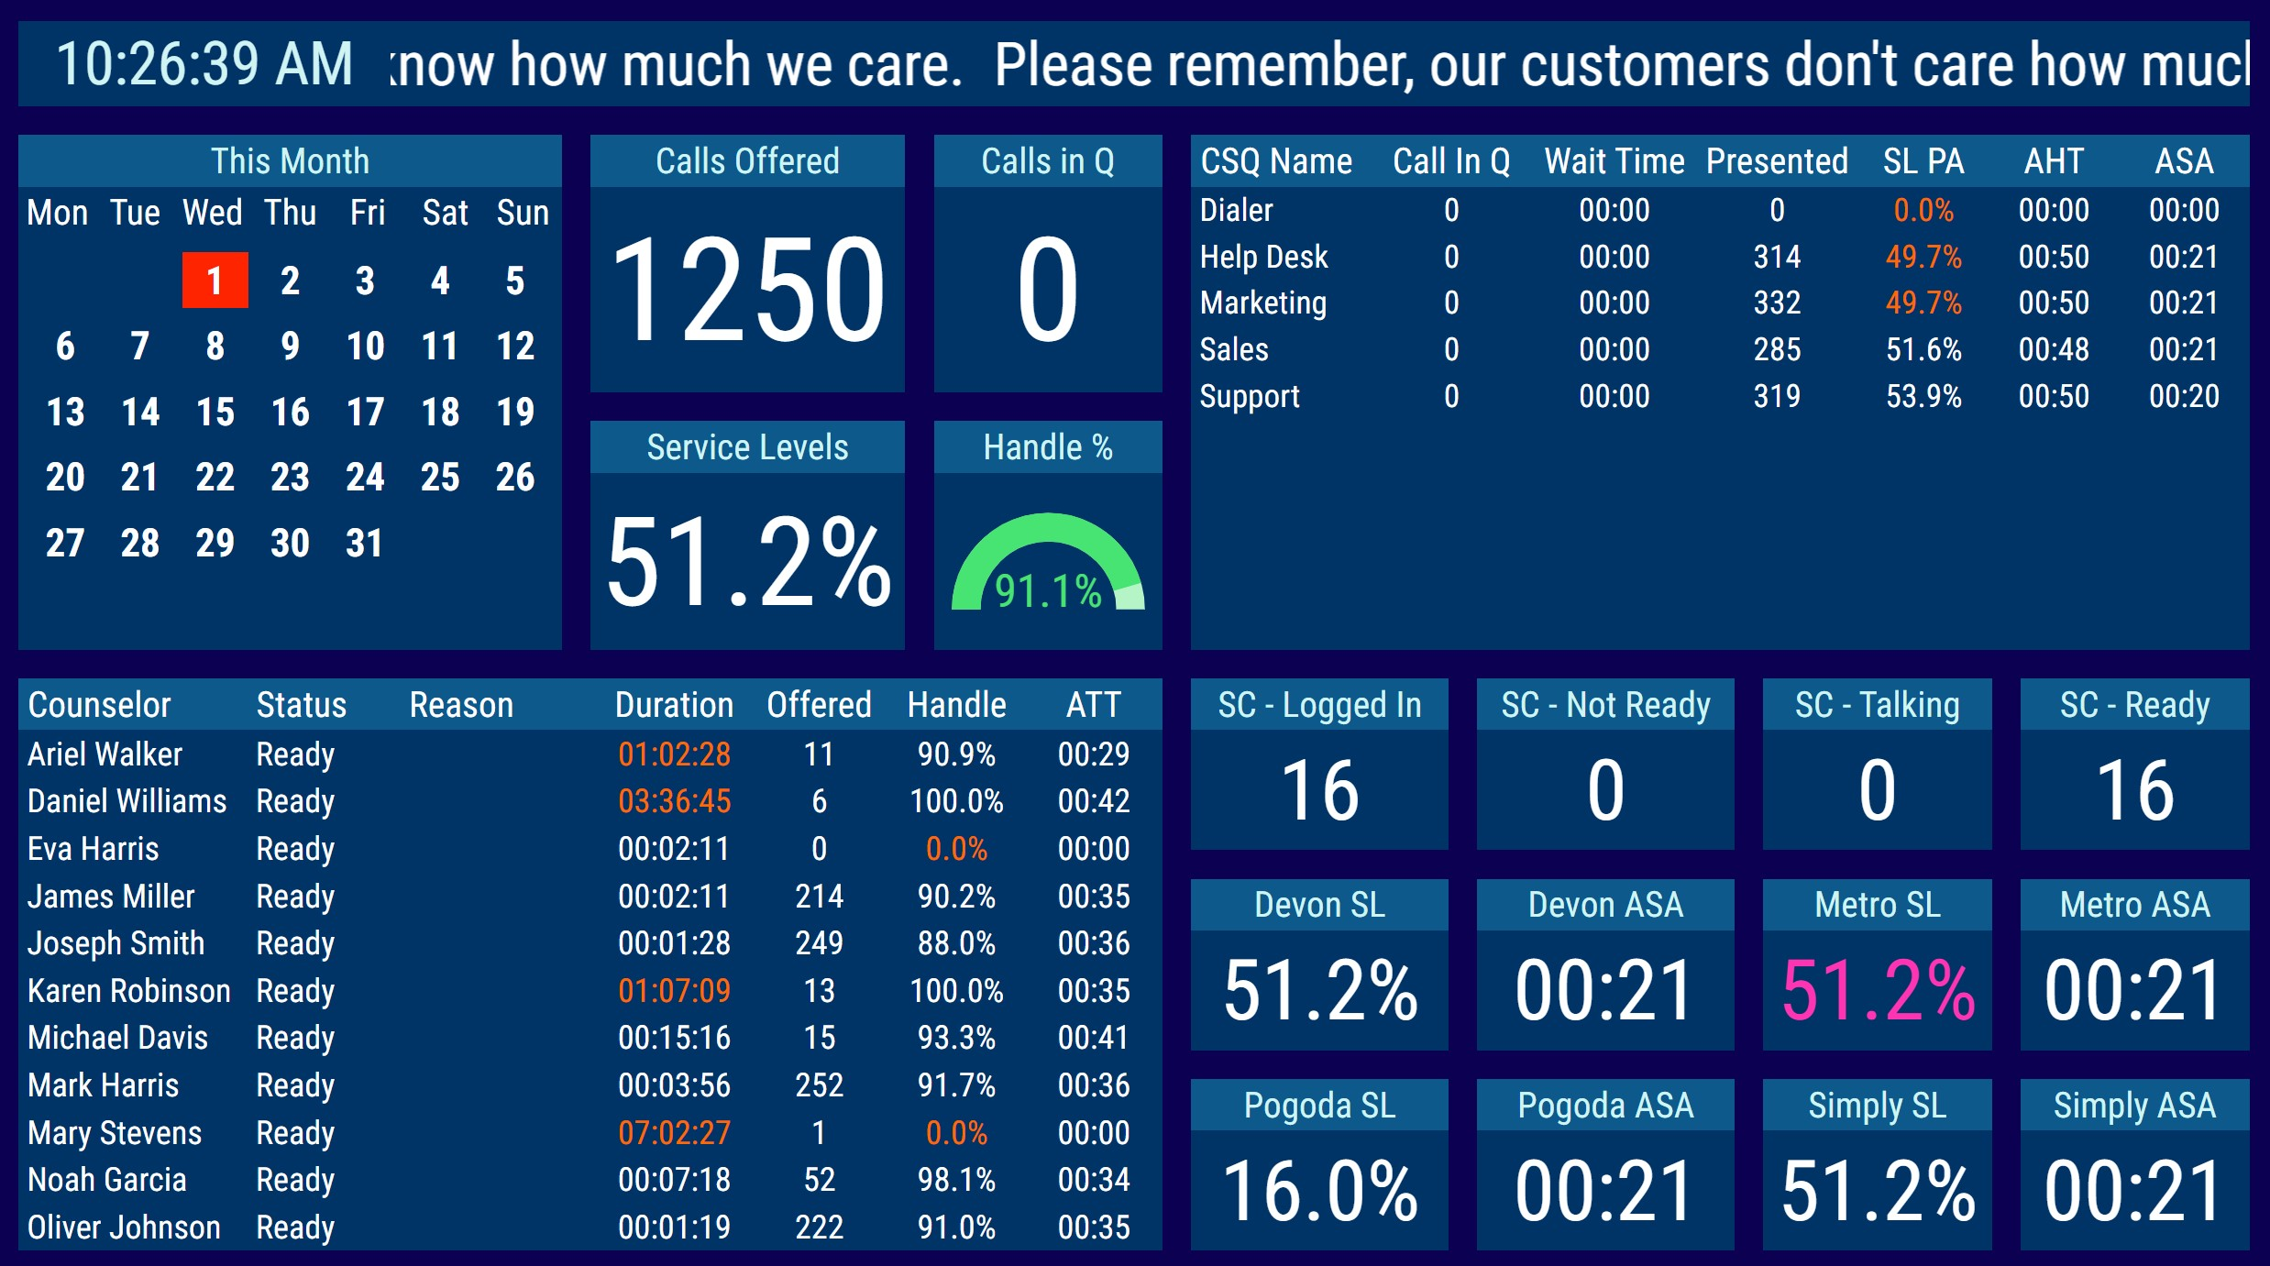
2Ring Dashboards & Wallboards Demo Video ..

Slide 9
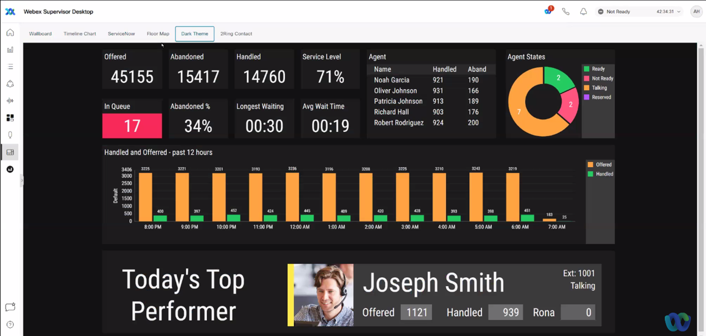
2Ring Dashboards & Wallboards Embedded in Webex CC ..

Slide 10
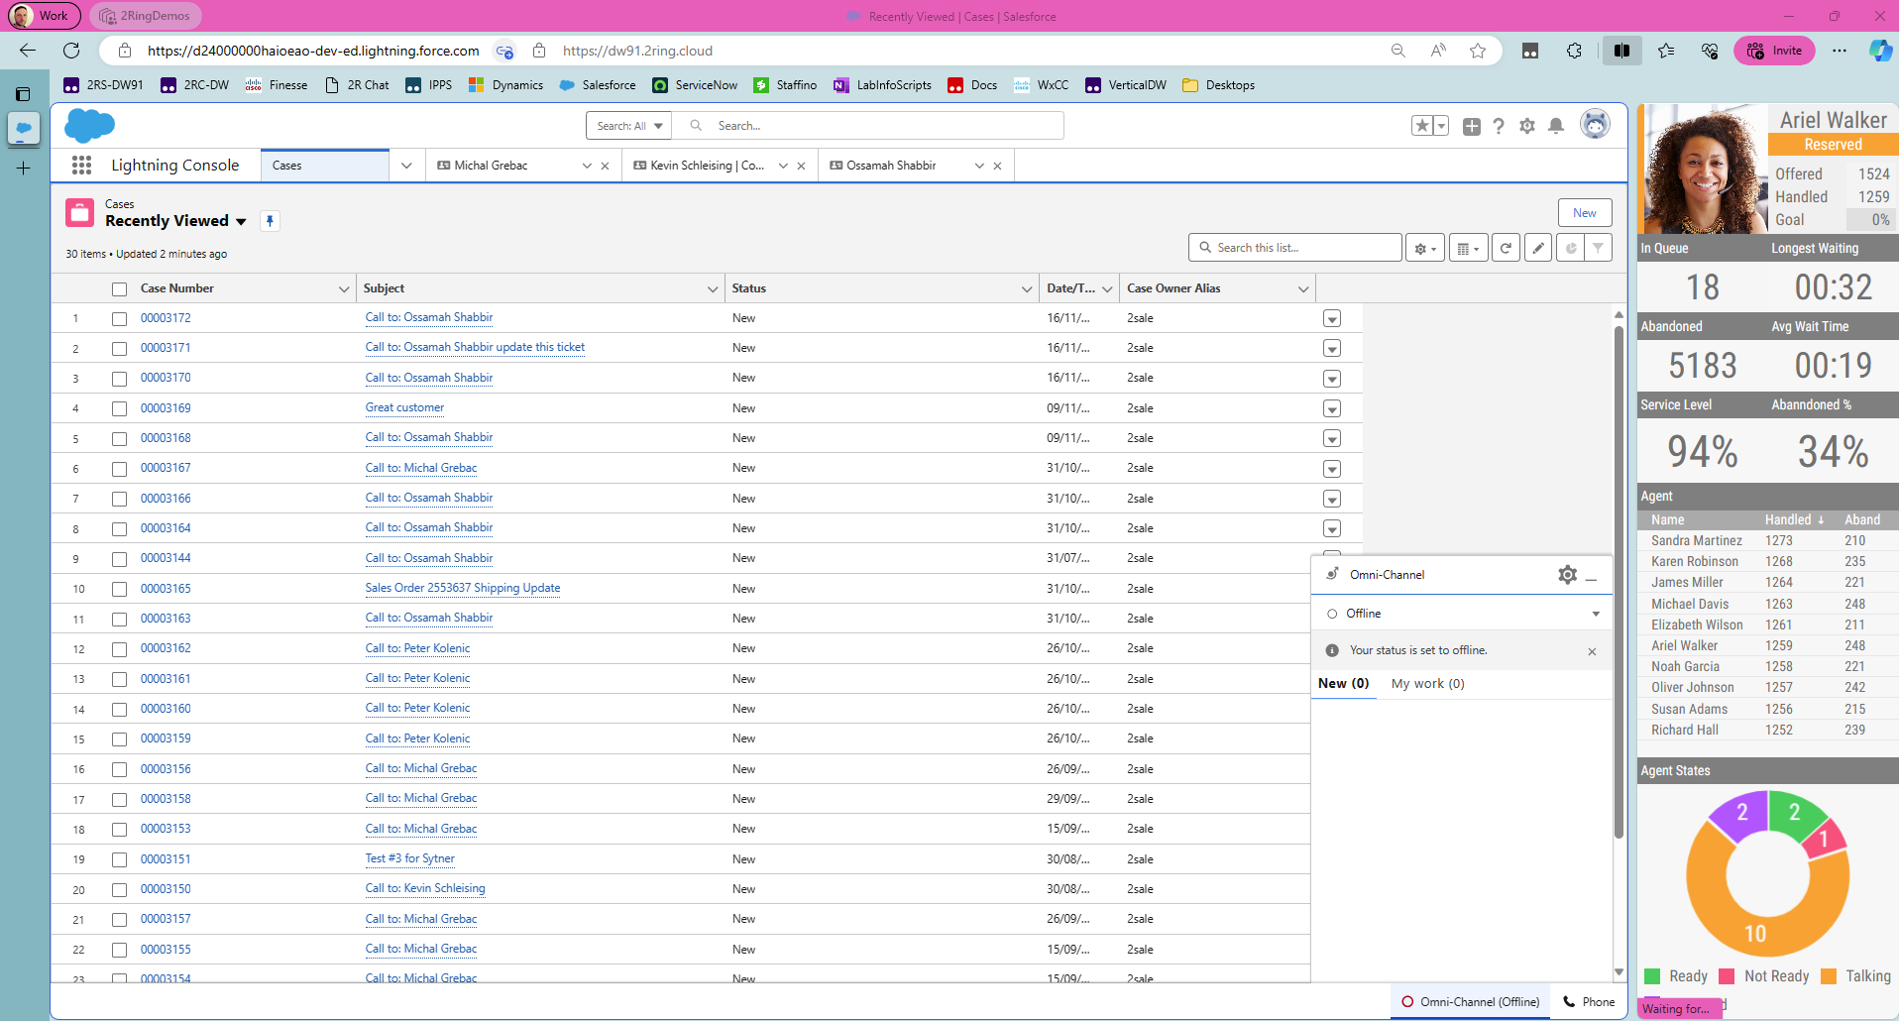
MS Edge: Personalized Layout Next to the CRM

Slide 11
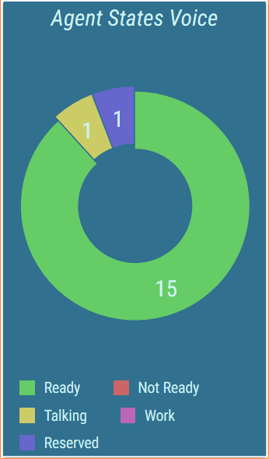
Real-Time Reporting Friendly to Business Users ..
A Web-Based Layout Editor
FULL control over every segment
All options available via context menus on the right
Changes shown immediately in the layout’s preview on the left
Layout Parameters: create a single layout to deliver thousands of personalized views to your agents
Layout can define parameters that are inherited by all KPIs, grids, charts, etc. When the value of the parameter changes on the layout, all child sources reflect it automatically.

Slide 12
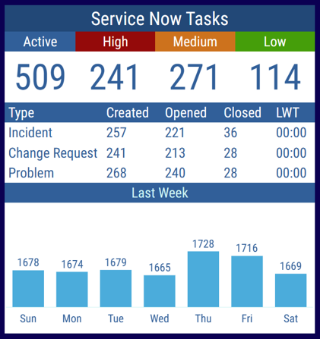
Use Multiple Data Sources ..
Include additional business relevant information from:
ServiceNow
Salesforce dashboard elements*
SQL*
Combine multiple tables from the same or even from different connectors (a grid can be composed of multiple tables, e.g. a single grid displays stats from a call center, and a ticketing system).
Build layout with data from multiple sources – e.g. service desk: 2Ring.com/TryItServiceNow
* Self-Host Only

Slide 13
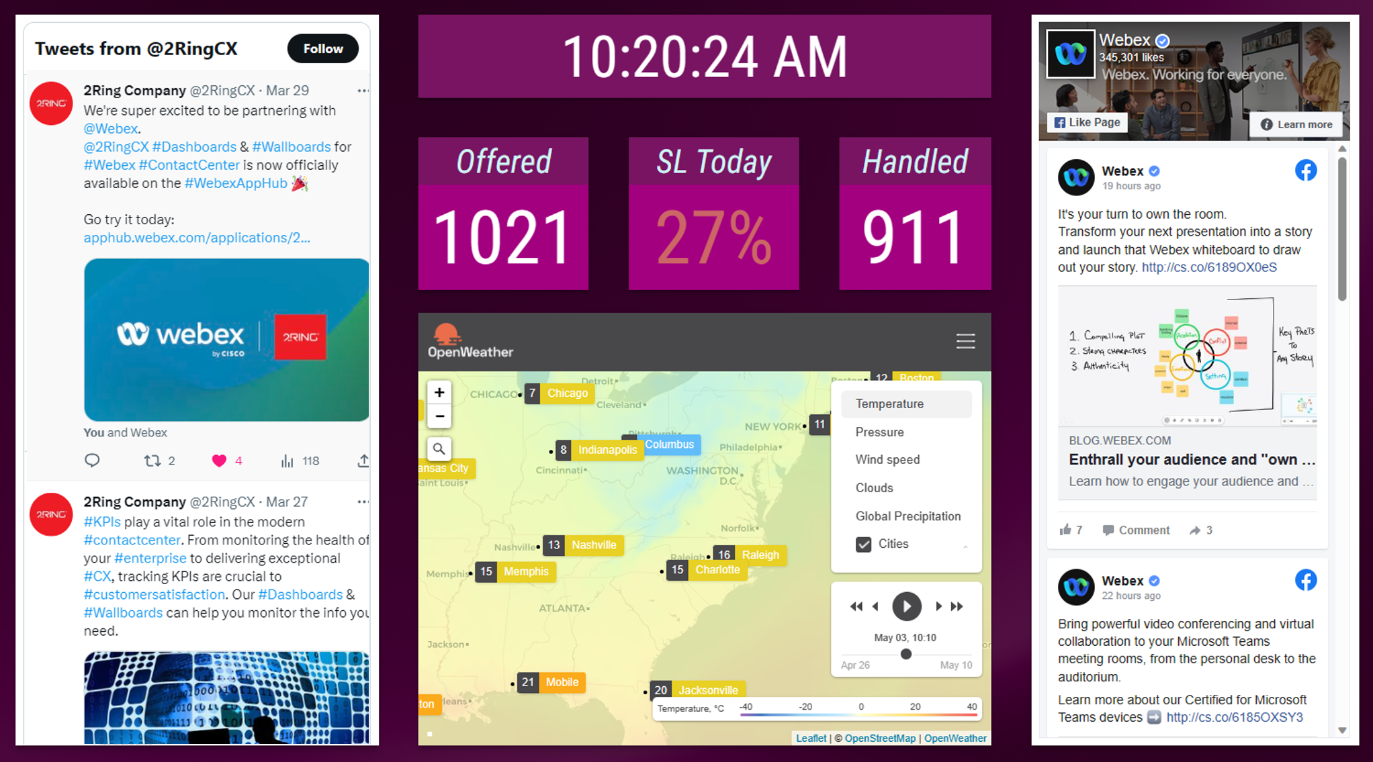
Additional External Content Types .. Digital Signage
Current time & date
Images
Marquees & Tickers
PPT / PDFs
Social media feeds
YouTube videos
Weather
Web pages - anonymous, iframe

Slide 14
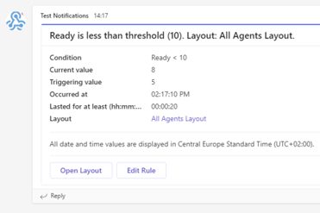
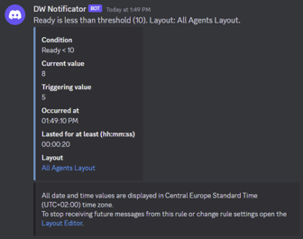
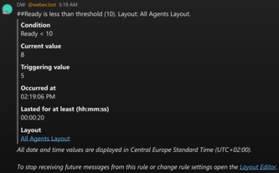
Real-Time Thresholds & Alerts ..
Pick your KPI / metric
Define your thresholds
Display alerts on your layout by
Changing color & Blinking
Playing a sound / announcement (audio recording)
Deliver alerts via email or to IM Clients (Webex, MS Teams, Discord, Slack), and/or via SMS/texting*
* A supported Texting API or Webex Connect Account to be provided by the end-customer

Slide 15

Business Units ..
Split users among multiple BUs to:
Define security boundaries
Split content into thematic containers
Manage filters to map to your teams in contact center
Business Unit
Owns layouts and media files
Owns user accounts and security settings
Sets ip filter restrictions

Slide 16
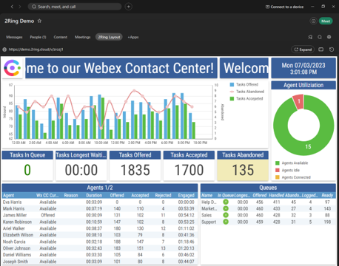
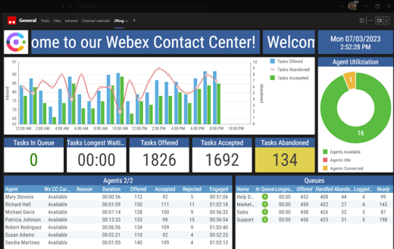
External Users & Sharing Access ..
Make it easy for the corporate executives to see what’s happening in the contact center
Embed layouts into Webex space
Embed into MS Teams Channel
Share Layouts
with other BU administrators
Import/Export
Shared BU
using permalinks with Anonymous Access
Display on Large Screens
Self-hosted vs. Cloud

Slide 17
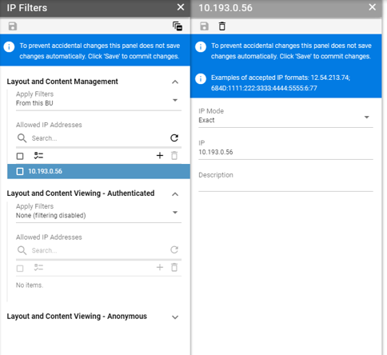
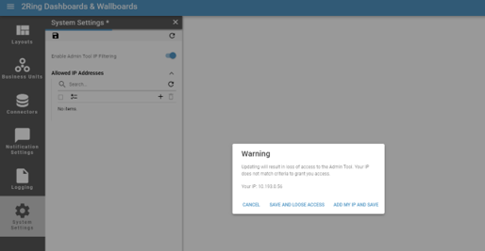
2Ring Cloud .. IP Filtering
Control access to your data across Internet or corporate network
Define access filters for
Specific Business Units
IP addresses or ranges

Slide 18
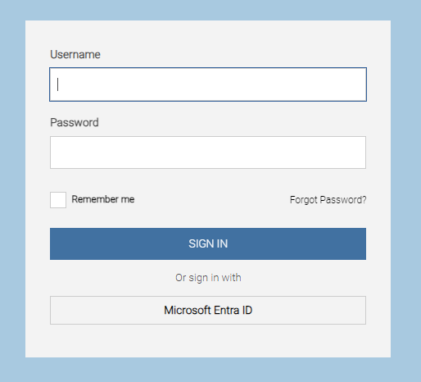
2Ring Cloud .. Single Sign On
Import users from your corporate directories:
Azure Entra ID (formerly Azure AD)
Okta
Authenticate using credentials your users already know
Take advantage of all your corporate security controls such as
MFA
Password complexities

Slide 19
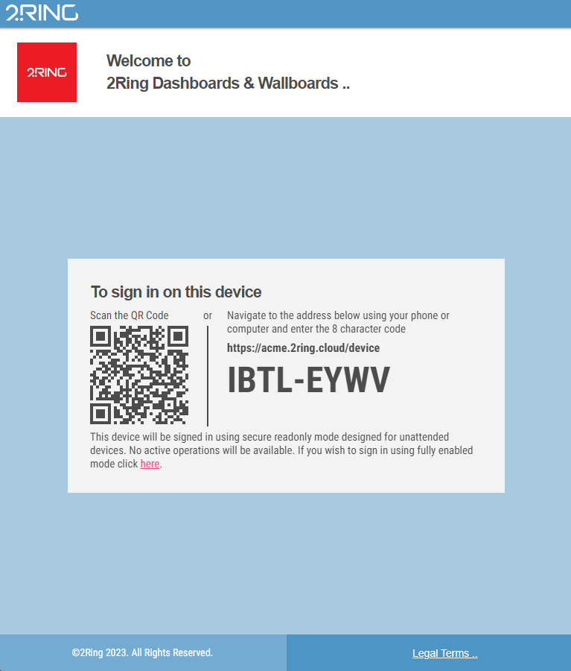
Device Friendly Login Experience
Sign in to TVs, Digital Signage and other keyboard less devices with ease
Use a QR code to sign in
Securely from a PC or your cell-phone
Devices gains read-only access
Sign in once, stay signed in until sign-out

Slide 20
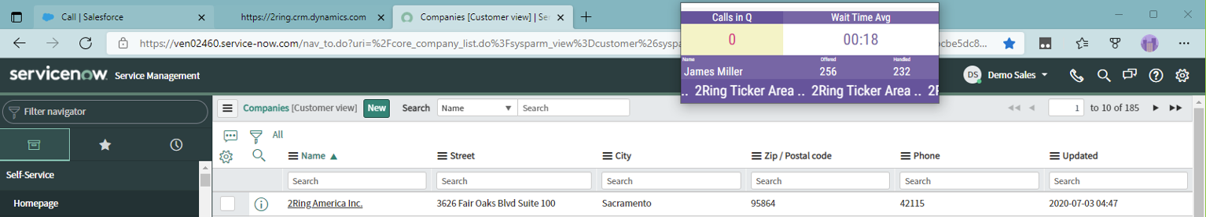
2Ring Power Tool (Personalized Wallboard) ..
Personalized grids – create one layout and every agent sees his/her metrics only
Flexible window size with embedded layout auto-resizing to the space provided
Metrics can change colors and blink based on thresholds
Ability to be always visible on top of all other windows
Remembers its position on the screen and its own window size
Can be set to auto-launch once agent logins to her/his workstation
Can contain a team-based message ticker – scrolling marquee
Deliver toast alerts based on any of the configured KPIs*
Notes:
* It works on the same principle as shown on slide 14. It is necessary to define a condition (threshold) and if it is met, a rule gets executed.

Slide 21
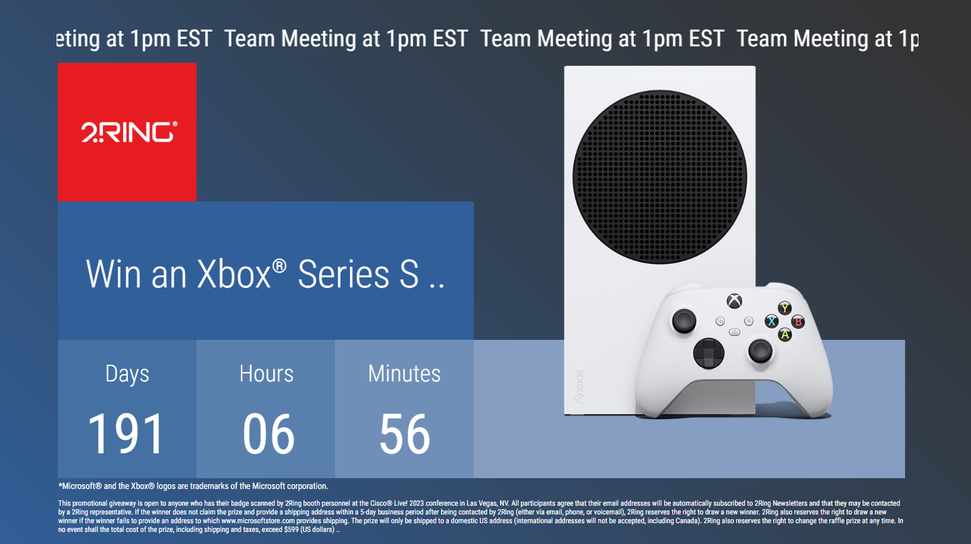
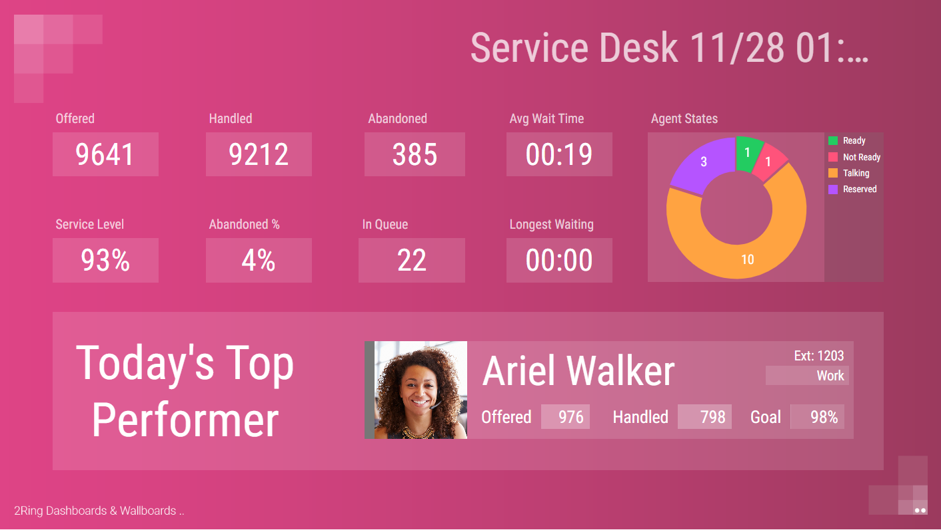
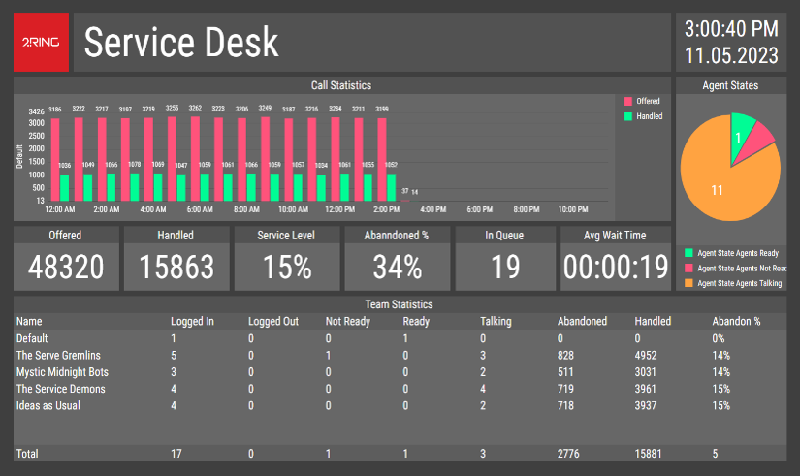
Your Content & Your Style ..
Use a background image or settle on a solid color
Use built-in fonts or supply your own
Filter, sort, and auto-page your grids for Agents, Queues etc.
Sequence segments or entire layouts
Combine multiple values into a single row (merge multiple queues into a single row)
Create layouts to your specific Enterprise ‘design manual and branding
Ad-hoc grid sorting & filtering by users

Slide 22
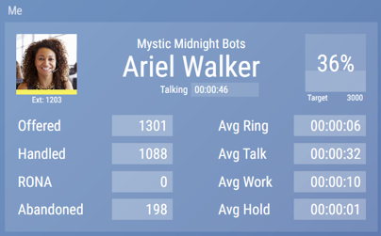
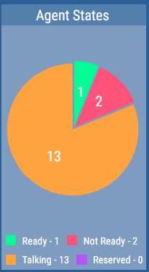
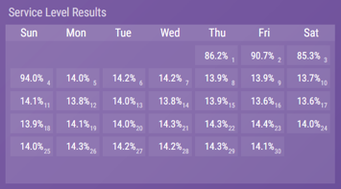
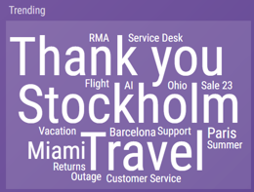
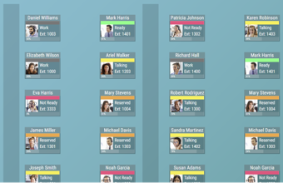
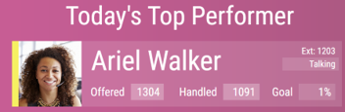
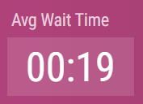
Widgets: Talking Heads / Floor Maps .. Pie Charts, Timeline Charts, Word Cloud

Slide 23
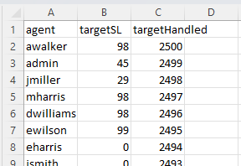
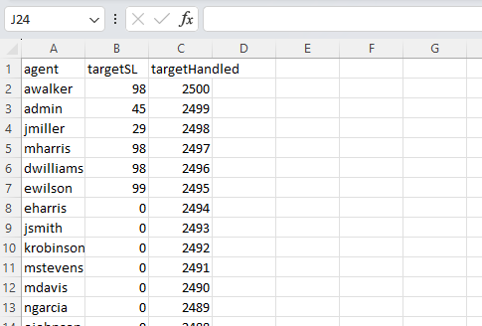
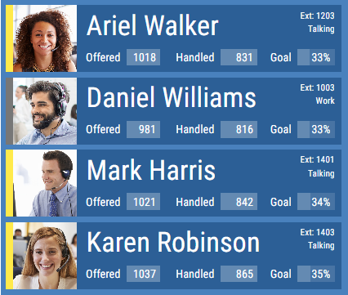
Importing Custom Data from CSV
Import and combine custom data with computed data provided by connectors
Suitable for tracking fulfillment of personal or team targets
Notes:
Calculations based on targets, e.g. % fulfillment of agent’s goal
Short notes displayed next to agent state in a list of agents

Slide 24
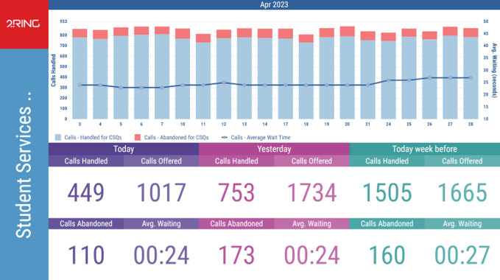
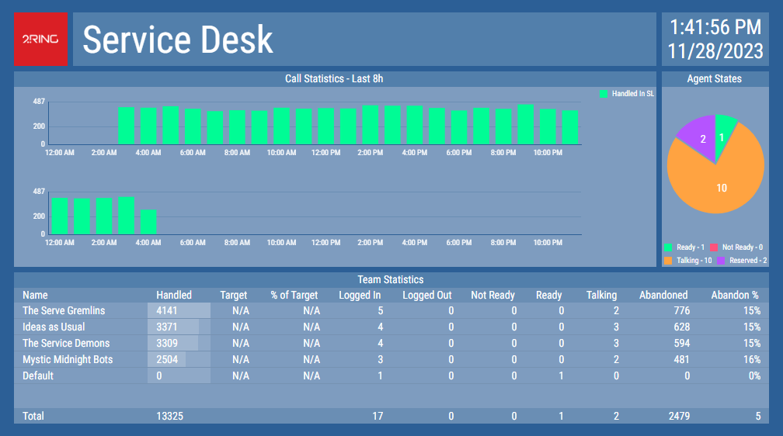
Historical Trending of Real Time Data ..
Compare current and past periods in easy to grasp charts
Average Wait Time This Month vs Last Month
Calendar Showing performance on each day of the month (if threshold for a team bonusa was met that day)

Slide 25
Media Content: Import media files to enrich your layouts ..
Use agent photos to personify agent stats
Play video, presentations, PDF files
Play audible alerts in reaction to key events in contact center

Slide 26
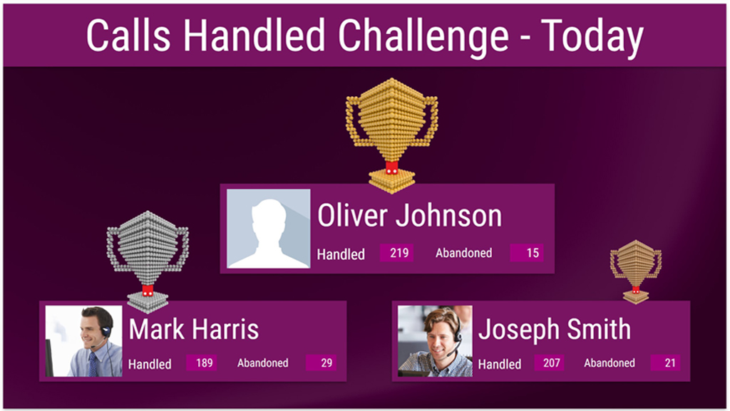

Gamification: Highlight Personal Achievements ..
Engage you agents to perform better by providing gamification targets and real-time score evaluation
Use dynamic layouts to position best performers on top of the podium
Combine data with visual elements to deliver any artistic outcome

Slide 27
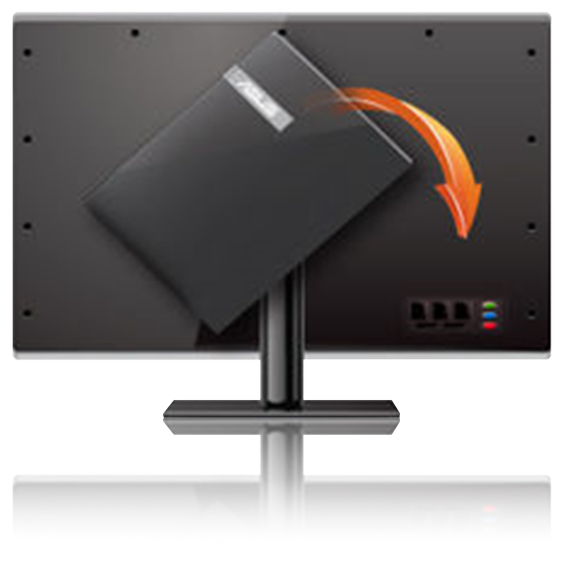
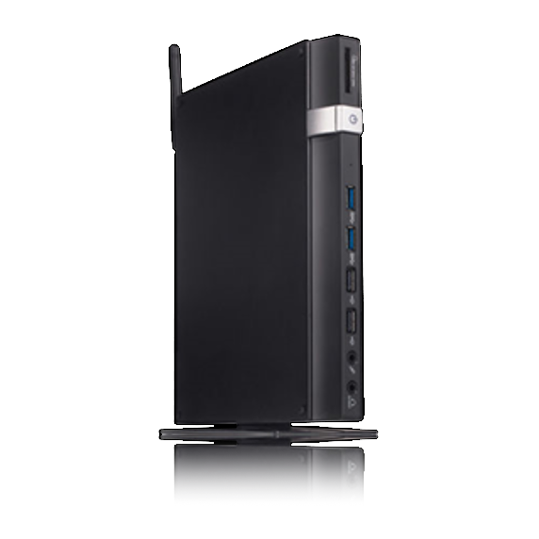
Hardware .. (not provided by 2Ring)
Screens
If you plan on using a smart TV, test it using www.2Ring.com/TryIt before purchase. E.g. Samsung has multiple different generations of smart TVs on the market, and older ones come with unsupported browsers.
PC / Mini-PC
Usually connected to a large screen via HDMI, VGA, or other cable.
Raspberry Pi
Enthusiasts can use Raspberry Pi. Reach out to us for tips.
PC or Smart Sticks
This is essentially a mini-PC which connects to the TV and has a browser running on it. There is no need to use TV remote control, you use your phone instead (login via QR code).
Digital Signage
2Ring also supports and integrates with AppSpace and Korbyt.

Slide 28

2Ring Dashboards & Wallboards: Technical Overview
http(s)
Smart Phones ..
http(s)
Tablets ..
http(s)
Workstations ..
Webex Contact Center ..
http(s)
Media Signage ..
REST API and Webhooks ..
Data Collection Mechanism ..
Screen ..
2Ring Cloud
Screen ..
Screen ..
Screen ..
Other Corporate Cloud-Based Data Sources ..
http(s)
PC
+
Splitter ..
http(s)
PC
Screen ..
http(s)
PC
Projector ..
ERP
Ticketing Systems

Slide 29



2Ring Dashboards & Wallboards: Technical Overview
Cisco Cloud (Cisco Cloud Region)
Possible Region Boundaries
Tenant
Tenant
Tenant
Tenant
HTTPS/REST
HTTPS/WebHooks
HTTPS/WebSockets
2Ring Cloud (MS Azure Region)
Customer Premises
Kubernetes Cluster
Tenant Namespaces
HTTPS
Cloud Connector
Database
Tenant Services
Web Application
Gateway
Configuration Management
File Storage
L7 Firewall
DDOS Protection
Load Balancer
Geo Fencing
OWASP 3.1 Filter
Customer
Work from Home User
Shared Services
HTTPS

Slide 30
About 2Ring ..
Founded in 2001
Global Presence / Customer Base
European HQ in Slovakia
North America HQ in Sacramento, CA
ISV Partner with Cisco, Amazon, Calabrio, Five9, Genesys, Microsoft, NICE CXone, and ServiceNow.
100% Focus on Indirect Sales Strategy

Slide 31




Contacts ..
2Ring .. Questions
Michal Grebáč Strategic Sales & Marketing Director +1-916-514-3355 mgrebac@2Ring.com
2Ring .. EMEAR
ADDRESS Galvaniho 15/C 821 04, Bratislava, Slovak Republic OFFICE +421-2-5822-4550 EMAIL info@2Ring.com WEB www.2Ring.com
Peter Kolenič Channel Director, EMEAR +421-2-5822-4379 +421-903-500-494 pkolenic@2Ring.com
2Ring .. Americas & APAC
ADDRESS 3626 Fair Oaks Blvd. Suite 100 Sacramento, CA, 95864, USA OFFICE +1-916-426-3790 EMAIL Info-na@2Ring.com WEB www.2Ring.com
Michal Grebáč Strategic Sales & Marketing Director +1-916-514-3355 mgrebac@2Ring.com
2Ring .. Links to Remember
DW Product Site Request Instant Access to DW (Cloud) Request a Live Demo View a Sample Wallboard Layout Ordering Help (Solutions Plus)
2Ring.com/WebexCC ..
2Ring.com/DWWebexCCTrial ..
2Ring.com/WebEx ..
2Ring.com/TryItWXCC ..
2Ring.com/solplus

