Slide 1
2Ring Dashboards
& Wallboards ..
Real-Time Reporting & Alerting
Learn More: 2Ring.com/DW
Public Demo Cloud: 2Ring.com/DWTrial
Instant Sample Layout: 2Ring.com/TryIt

Slide 2
About 2Ring ..
Founded in 2001
Global Presence / Global Customer Base
European HQ in Slovakia
North America HQ in Sacramento, CA
Among 1000 Europe’s Fastest Growing Companies in 2020
ISV Partner with: Amazon, Calabrio, Cisco, Five9, Genesys, Microsoft, Nice inContact, ServiceNow, ..
100% Indirect Sales Strategy

Slide 3
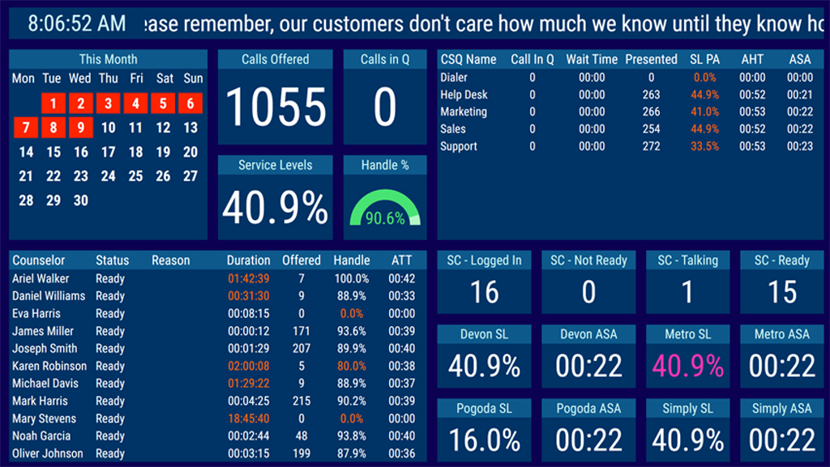
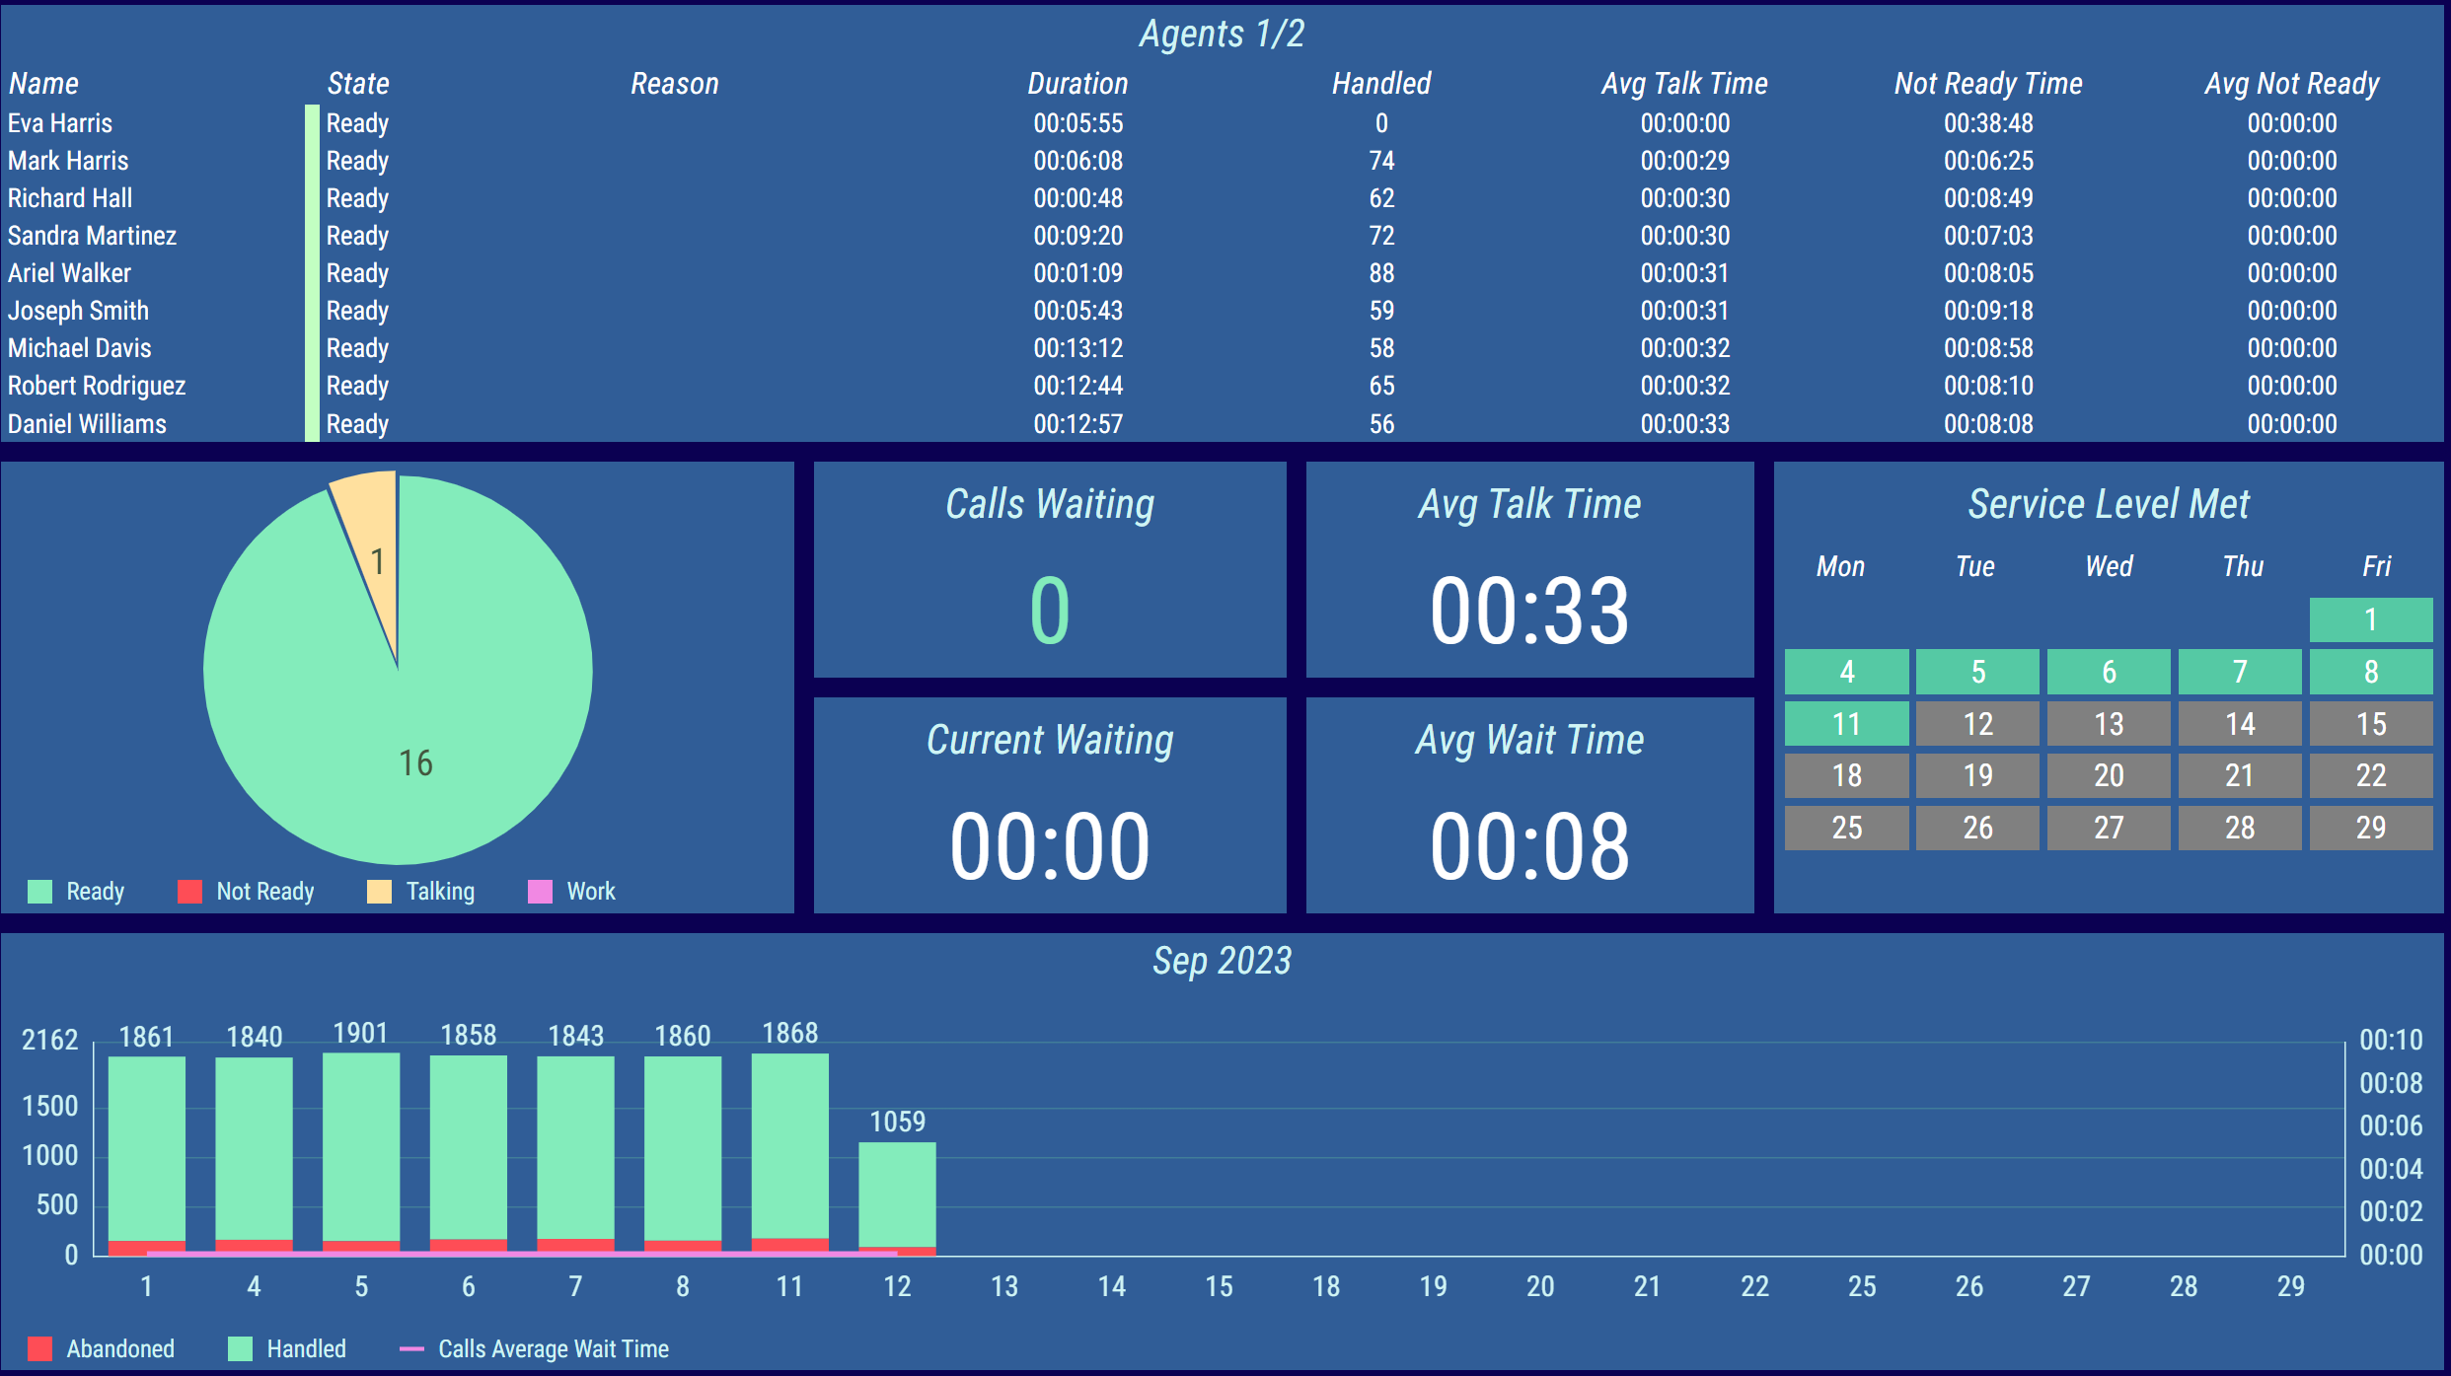
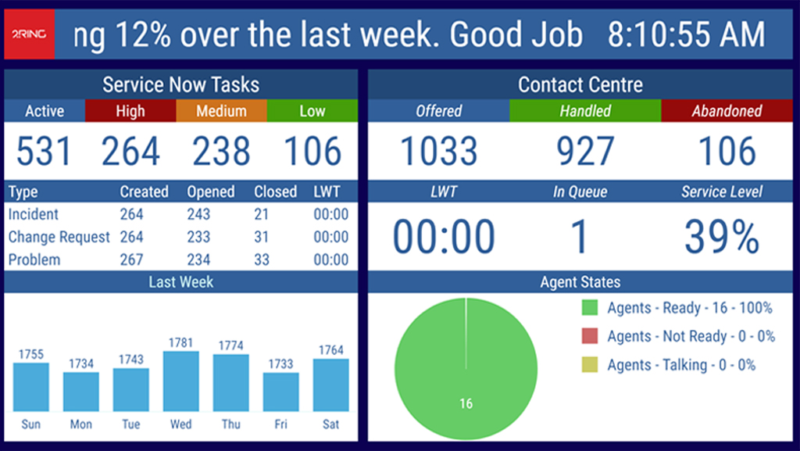
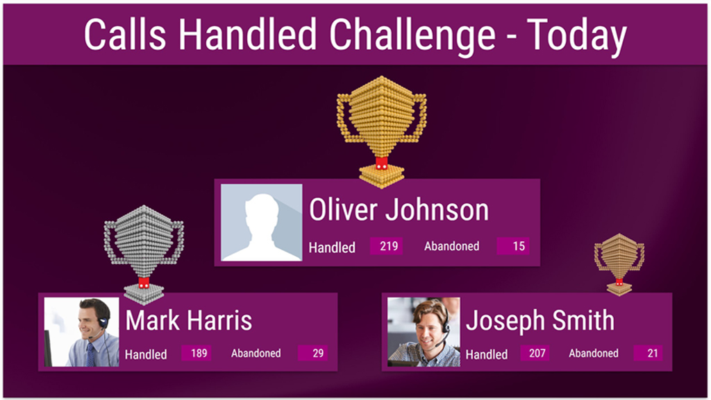
Deliver Eye-Catching & Flexible Layouts ..

Slide 4
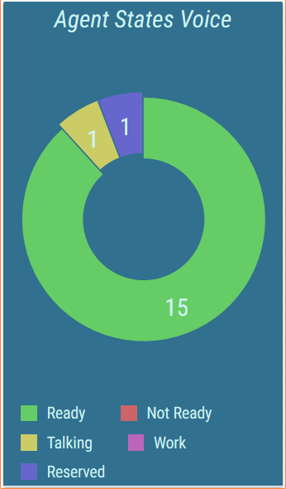
Real-Time Reporting Friendly to Business Users ..
Layout Editor (Web-Based)
Touch-screen friendly
Drag & drop support
All options available via context menus on the right
Changes shown immediately in the layout’s preview on the left
Layout Parameters
Layout can define parameters that are inherited by all KPIs, grids, charts, etc. When the value of the parameter changes on the layout, all child sources reflect it automatically.

Slide 5
Proven by Hundreds of Customers Worldwide ..
2Ring has revolutionized our ability to easily communicate key metrics to our entire organization. It has proven to be a versatile tool that can easily tie back to data from our latest generation phone system as well as our legacy systems. Overall, we are extremely happy with its functionality and ease of use.
The support team have always been quick to assist with the task and followed up until resolution. They have also assisted me in learning a little bit with each ticket so I can eventually be self-sufficient. A big kudos to the technical support team.
.. our supervisors are often pulled in multiple directions at the same time. The 2Ring solution has given them greater visibility and therefore control over our queues and agent management.
When we first started looking for a real time reporting wallboard application, we had a fundamental requirement. The selected solution needed to provide meaningful live data to support our self-management efforts and track our KPI performance. In addition, the selected platform had to be supportable by our contact center team with little to no effort/support and/or burden on our IT/IS team. I’m happy to report that after several months of utilization we can say proudly that we selected the correct solution. If you want a top performing tool supported by a great team, 2Ring is the correct choice for your organization.
Our 2Ring solution is providing much needed visibility for both our affected employees and management. Seeing real-time queue and agent status has contributed to more awareness around the organization’s ability to handle incoming patient calls to appointment schedulers and business office representatives.
The service we have received from 2Ring has been great, they don't let go until a problem is resolved and you understand what happened. I would suggest their products and services to any HealthCare organization in the world.
We needed a true wallboard solution for our Contact Center. We needed an application that would not only allow for real-time statistics but would make the actual day to day management of the tool user friendly. We vetted multiple vendors, went through multiple demos, and ultimately landed on 2Ring. The combination of cost, licensing model, familiarity with the product name and ease of implementation all factored in our informed decision-making process. While the IT Department had a technical opinion, the ultimate decision was made by our Contact Center team who ultimately approved due to 2Ring’s appealing layout and the ease of use of the product itself.
2Ring wallboard solution has provided a effective and efficient way to give us a visibility of our Call Center statistics. It also elegantly presents to our colleagues on what is being achieved by the Call Center.
Using 2Ring in our contact center helps our representatives make better decisions to assist customers more efficiently. Those that handle other functions aside from incoming call volume no longer need to wait for a manager to tell them to hop on to assist in our queues. They can make these decisions on their own which helps us not only create better experiences for our customers, but also empowers our representatives to be more efficient adding to their satisfaction.
I’ve been extremely pleased with the ease of configuration of 2Ring Dashboards & Wallboards. We examined many wallboard packages, and spoke to several different vendors during research, but 2Ring was head and shoulders above the rest in presenting a professional looking Wallboard that can be set up and modified with very little training necessary.
2Ring has offered us unparalleled insights into call volume and agent activity which has allowed our contact center to make informed decisions. We have expanded this to beyond our contact center into other departments such as our lending department and collections department, which has positively impacted our entire organization.
With the 2Ring dashboard we have been able to get the real time visibility we need to manage our call center. Each team member is able to see what the other one is doing, and we are able to coordinate our activities and minimize gaps in coverage. It’s been especially nice to have the flexibility to have different views for different skill sets, and control over the color coding and visuals of the KPI’s
Our 2Ring solution has dramatically reduced our SLO violations by bringing a much-needed visibility into agent status and capacity. The ROI on this product is almost immediate, within weeks we were consistently able to keep our SLO violations below thresholds. Having real time visibility of agent status and capacity of agents that those agents can view, minimizes management overhead, allows agents to capacity plan on the fly, and results in more client calls getting answered faster.
As the Call Center is not located in our corporate office, I monitor the Wallboards remotely from an iPad at my desk, which provides real-time visibility of call volumes and hold times. I really can’t recommend this software enough for its ease of use and real-time visibility.
.. a great addition to our Contact Center. It has given us many new capabilities that have increased our productivity and helped us serve our customers more efficiently.
2Ring allows us to present call data to managers and executive staff in real-time on their desktop, monitors and other devices without the necessity of creating accounts in Cisco, consuming licenses or training users. The application is easy to customize for individual business units so they can view the information that is important to their operations.
I have been using the 2Ring Wallboard product for about 6 months now and I have been impressed with its ease of use – after about 8 hours of working with it I feel comfortable that I can create pretty much anything I want to create.
Whenever we need work done by 2Ring your team has come through and in a very timely manner always willing to make changes quickly and effortlessly.

Slide 6
How to Consume 2Ring
Self-Hosted Subscription
  Cisco UCCX – Express
  Cisco UCCE – Enterprise
  Cisco PCCE – Packaged
  Cisco Webex® Contact Center
  Cisco CallManager
  Cisco Unity
  Salesforce (dashboards)
  ServiceNow®
  SQL Based Databases
  CSV Imports
2Ring Cloud Subscription
  Amazon Connect®
  Cisco Webex® Contact Center
  Five9
  Genesys Cloud CX
  ServiceNow®
Pricing Notes
  Cover peak number of concurrently logged in agents + supervisors
  Activation fee can be waived for 3Y prepaid subscription with 50 or more seats (pending 2Ring’s approval)
  12-month min. term

Slide 7
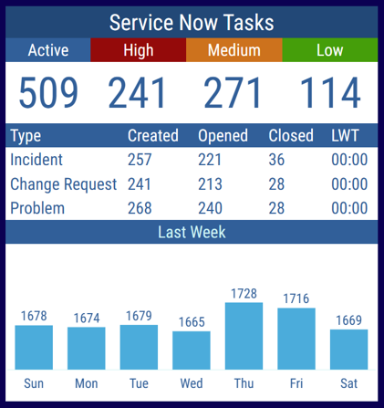
Use Multiple Data Sources ..
Include additional business
relevant information from cloud-based data sources, such as
ServiceNow
Salesforce
SQL-based Databases
A grid can be composed of multiple tables. Combine multiple tables from the same or even from different connectors. E.g. a single grid displaying stats from a call center, and a ticketing system.
Build a unique layout for each department – e.g. service desk: 2Ring.com/TryItServiceNow

Slide 8
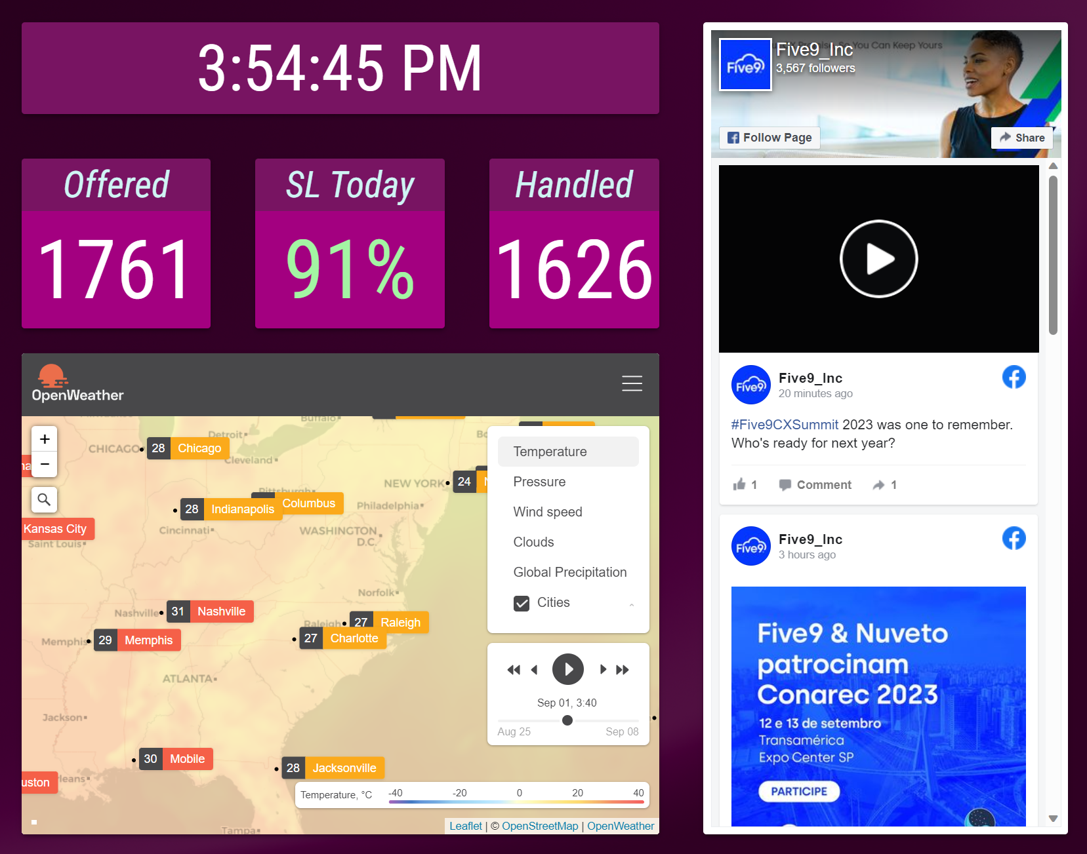
Additional External Content Types .. Digital Signage
Current time & date
Images
Marquees & Tickers
PPT / PDFs
Social media feeds
YouTube videos
Weather
Web pages - anonymous, iFrame

Slide 9
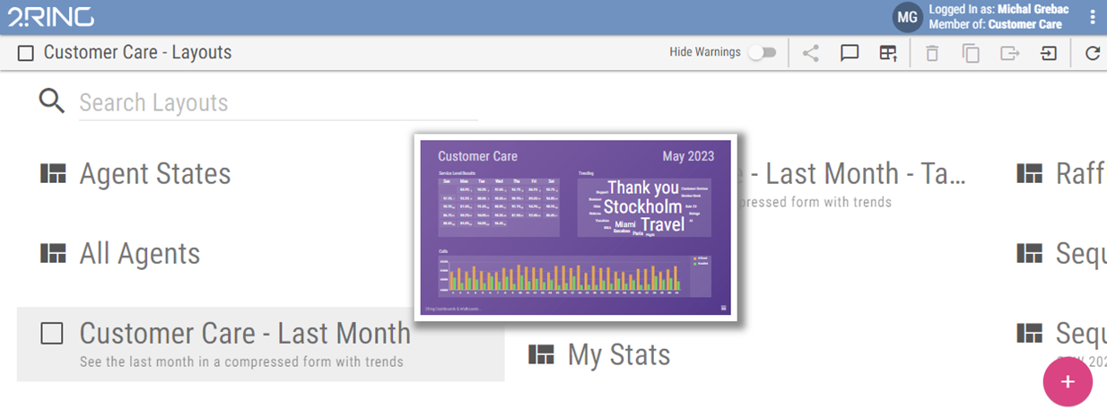
Live Layout Previews
Hover your cursor over the layout’s name to see a Live Layout Preview with current and continuously updating values
Previews appear instantly and simplify choice of the layout to view
Have a quick peek at current state without having to fully open a layout

Slide 10
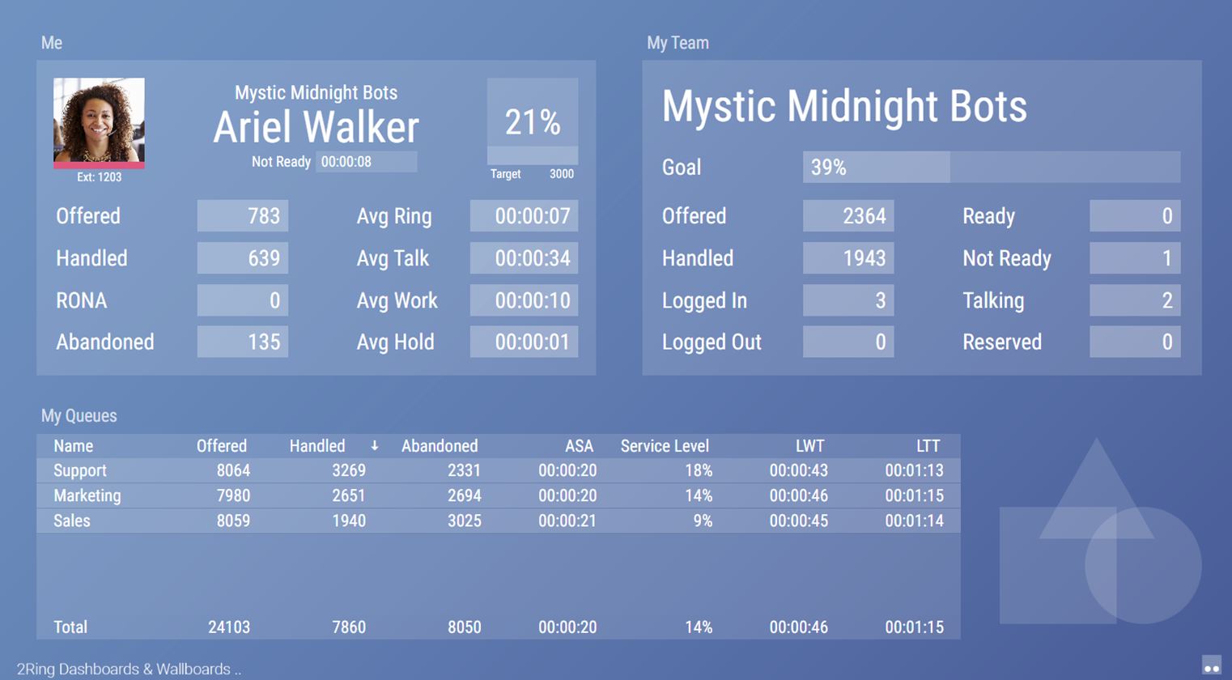
Real-Time Interactive Sorting & Filtering
Available in grids of displayed layouts
Sorting or applying filters takes just a matter of seconds
Filters retain between sessions (for the current user) until cleared

Slide 11
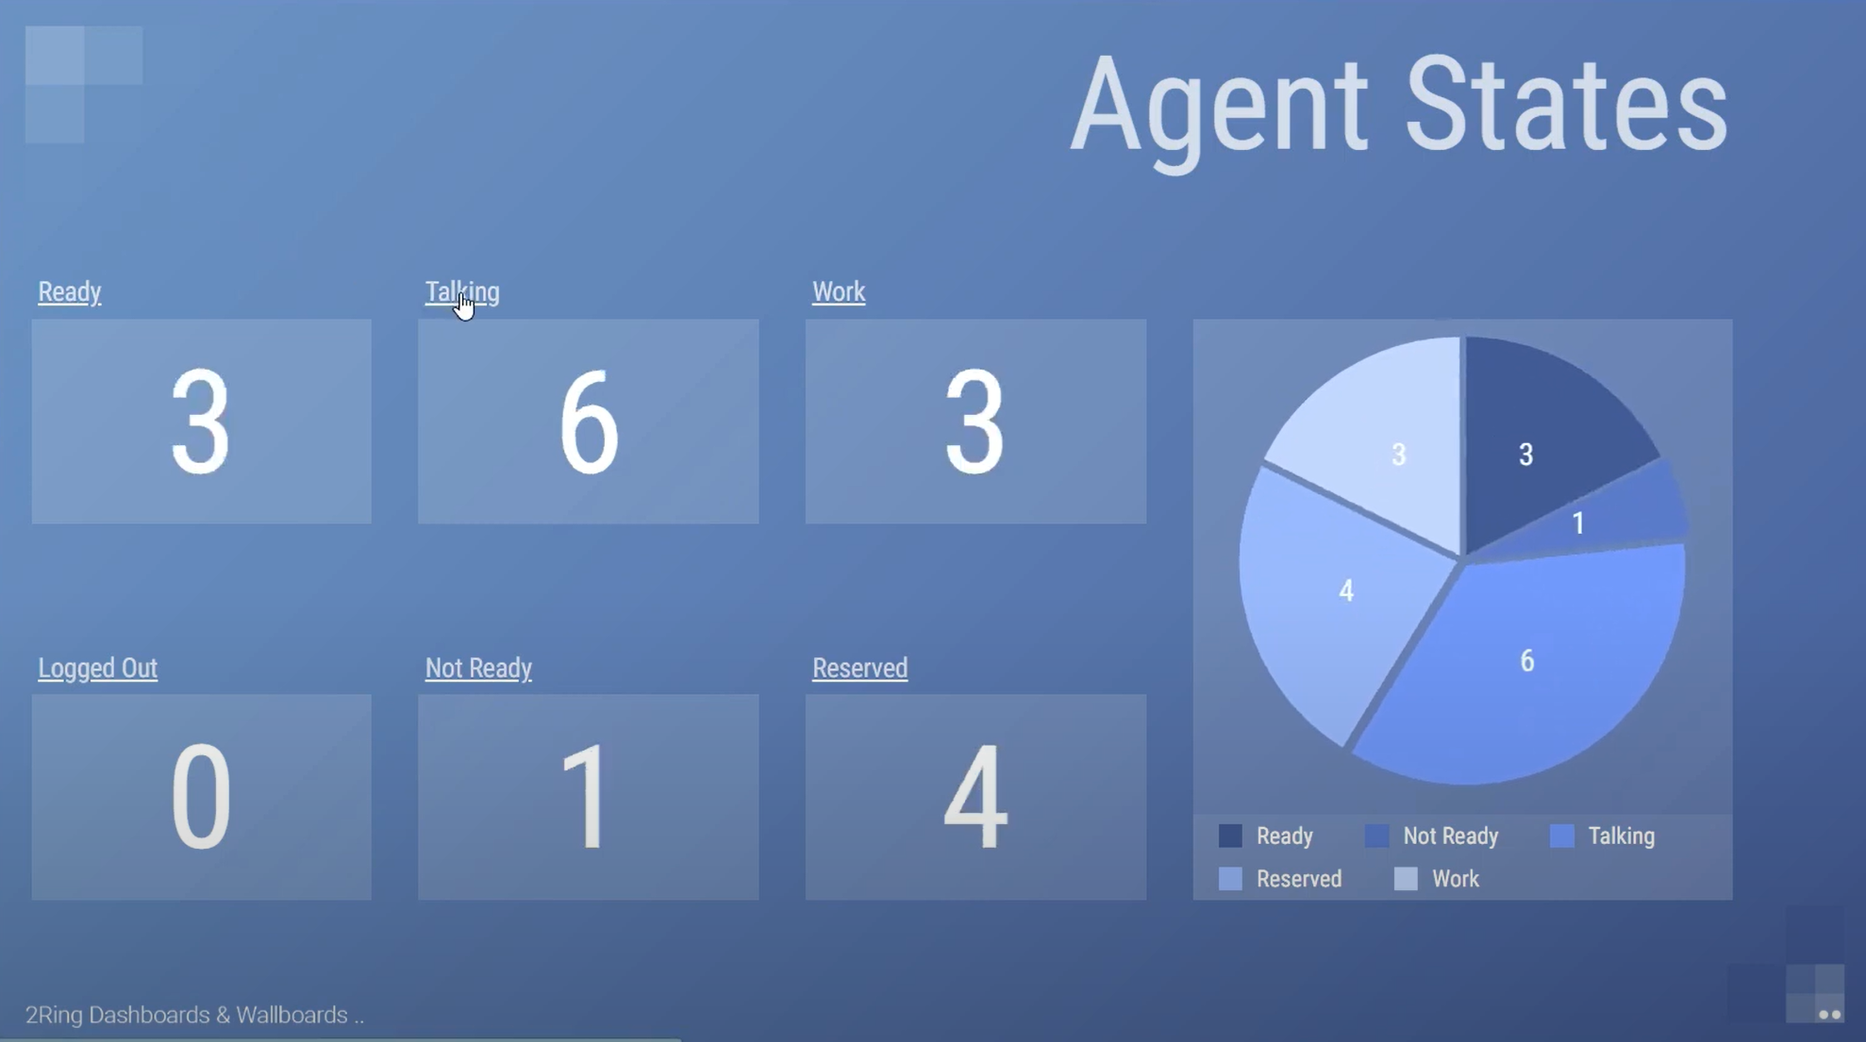
Drilldowns: Cross-linking to different layouts
This enables for the creation of 10,000 feet overview layouts
E.g. A single click can take your user to a layout with a detailed list of all agents currently in that given state or logged in to a given queue.

Slide 12
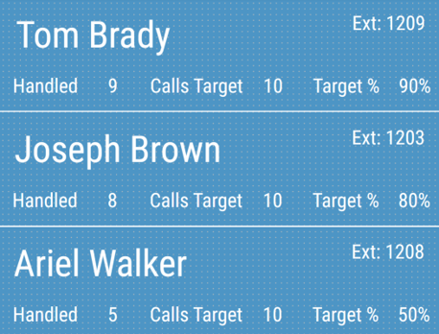
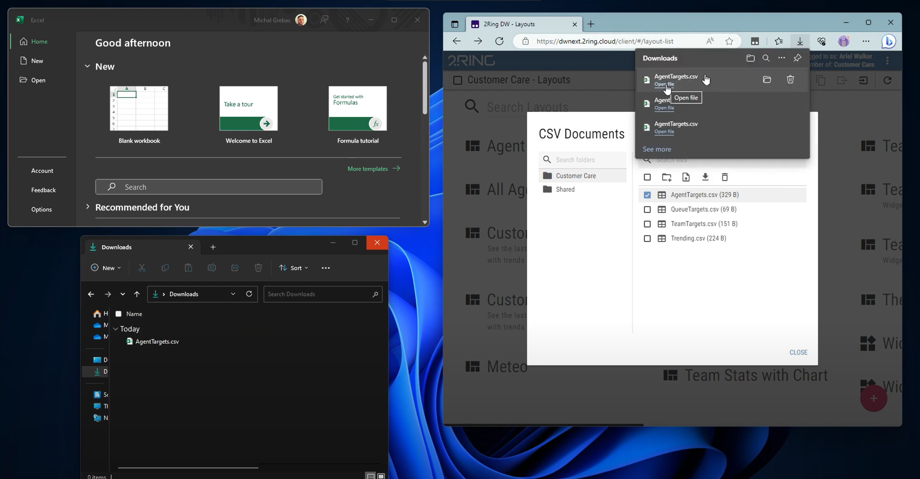
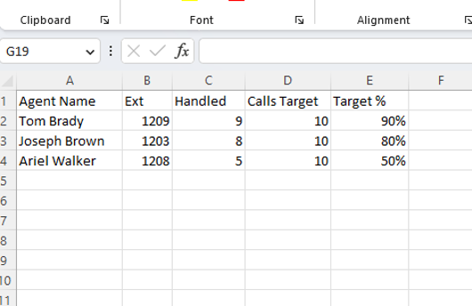
Upload Custom Tables from CSV files
Supervisors (BU admins) can upload custom tables from CSV files for use in their layouts, e.g.
  Personal targets for agents
  Notes displayed next to agent state in a list of agents
Used in calculations, e.g.
  % fulfillment of agent’s goal
Download file, open it in a spreadsheet application, make desired updates, save changes, and finally, upload the file back.

Slide 13
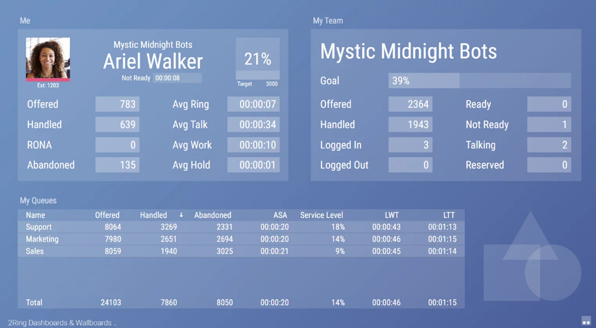
Create Personalized Layouts
Design a layout where each user can access the same link but view only their respective data.
Watch a short video showing the same layout accessed by two different users and an administrator who doesn’t have any contact center data

Slide 14
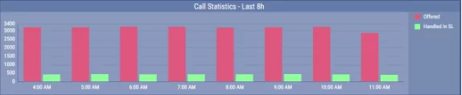
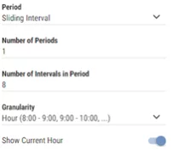
Sliding Intervals for Timeline Charts
Timeline Charts now also support sliding intervals as one of the options for the period selection (e.g., last 8 hours, 3 weeks, or 2 months)
You can now maximize space utilization by e.g. displaying only the most recent 7 days of data, eliminating the need to allocate valuable space for a two-week period

Slide 15
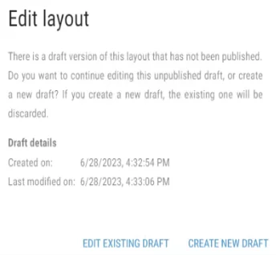
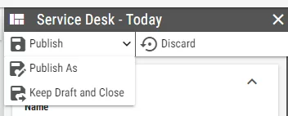
Save Layout Draft and Publish As
Layouts can be saved without publishing. Work can be resumed late.
Layout can be published to a new copy in its current state without changing the original.

Slide 16
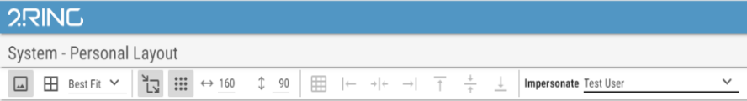
How do Others see My Layout?
While editing a dynamically filtered (usually Personal) layout, the layout creator can now test how the layout would appear for a specific user.

Slide 17
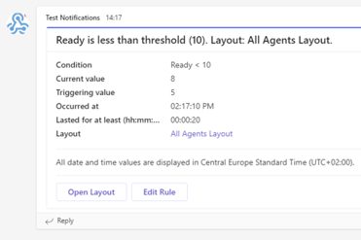
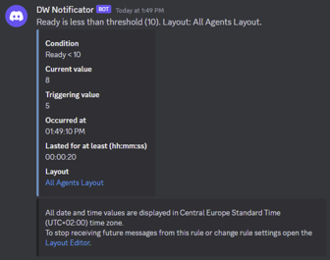
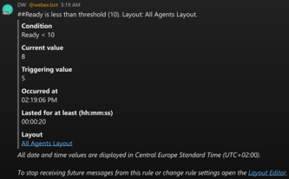
Real-Time Thresholds & Alerts ..
Pick your KPI / metric
Define your thresholds
Display alerts on your layout by
  Changing color & Blinking
  Playing a sound / announcement (audio recording)
Deliver alerts via email or to IM Clients (Webex, MS Teams, Discord, Slack), and/or via SMS/texting*
* A supported Texting API to be provided by the end-customer

Slide 18

Business Units / Data Silos ..
Split users among multiple BUs
(layout or data silos), so everyone can only see and/or mange their layouts
Integrate 2Ring with Microsoft Azure AD for easy user management & access control.

Slide 19
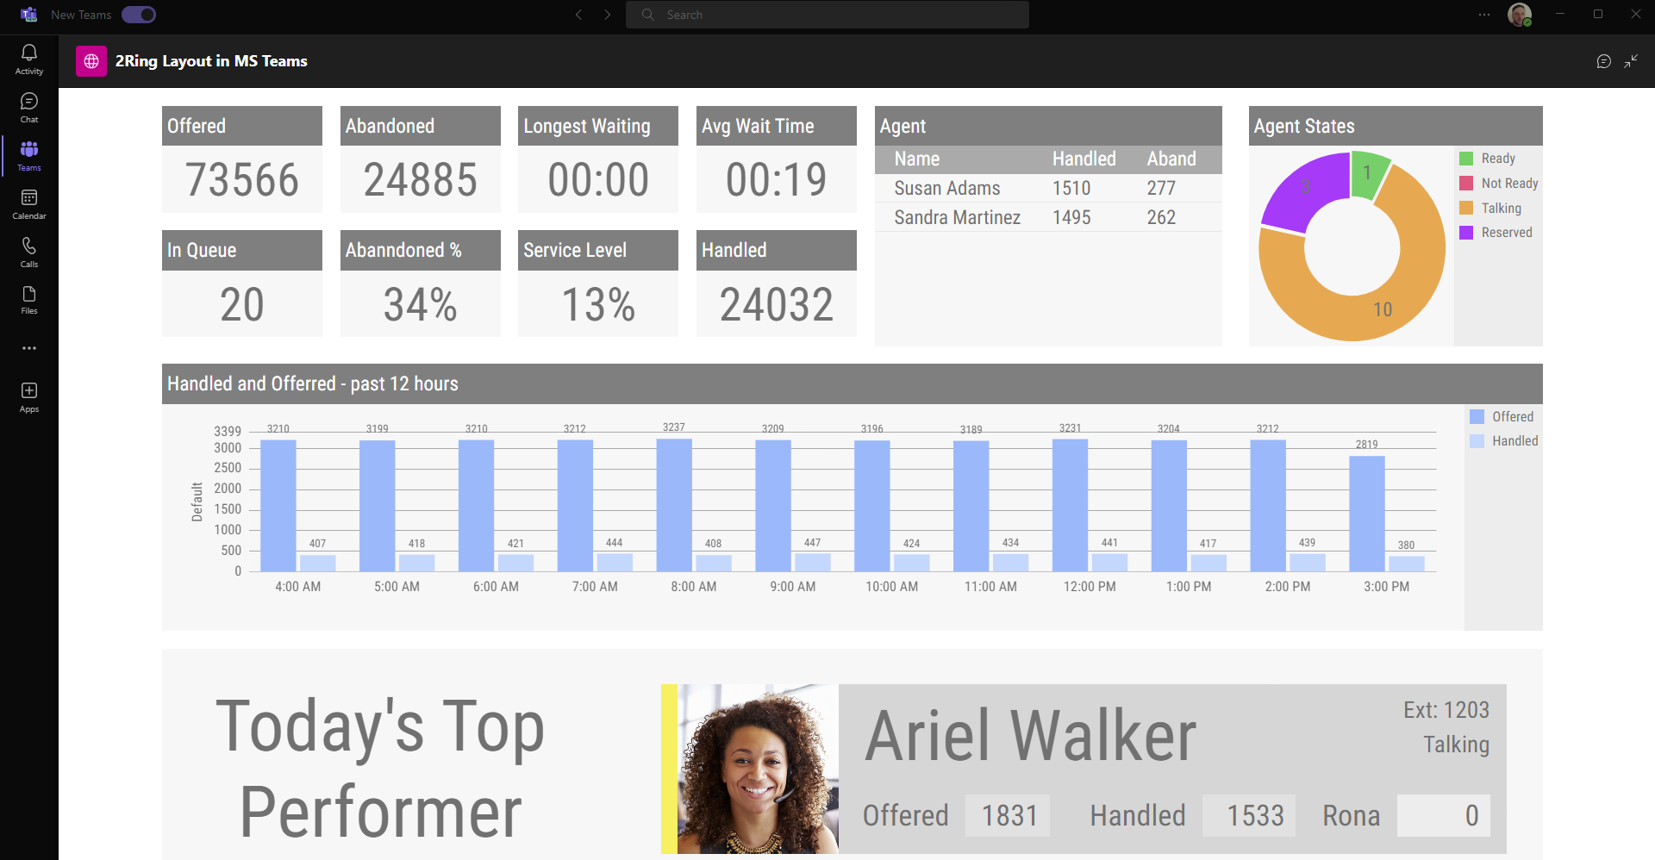
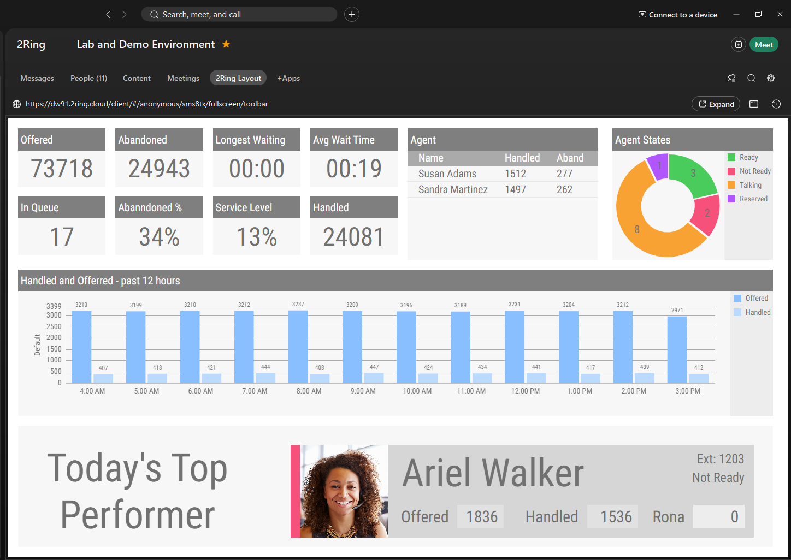
External Users & Sharing Access ..
Make it easy for the corporate managers to see what’s happening in the contact center
Embed layouts into Webex space or into MS Teams Channel
Share Layouts
With other BU administrators:
  Import/Export
  Shared BU
Using permalinks with Anonymous Access
Display on Large Screens
Self-hosted vs. Cloud

Slide 20
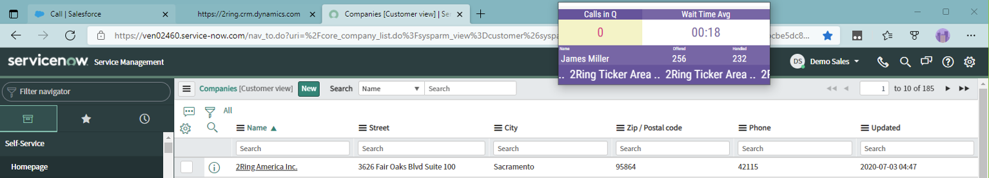
2Ring Power Tool (Personalized Wallboard) ..
Personalized grids
Create one layout and every agent sees his/her metrics only
Flexible window size
with embedded layout auto-resizing to the
space provided
Metrics can change
colors and blink based
on thresholds
Ability to a always
visible on top of all
other windows
Remembers its position
on the screen and its own window size
Can be set to auto-launch once agent logins to her/his workstation
Can contain a team-based message ticker – scrolling marquee

Slide 21
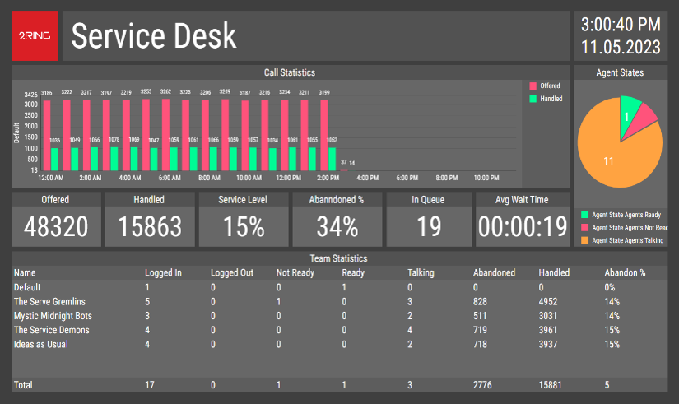
Your Content & Your Style ..
Use a background image or settle on a solid color
Drag & drop as many segments as needed, position and resize each to your liking
Pick colors, font types, & sizes
Filter, sort, and auto-page your grids for Agents, Queues etc.
Sequence segments or entire layouts
Combine multiple values into a single row
(merge multiple queues into a single row)
Create layouts to your specific Enterprise
‘design manual and branding

Slide 22
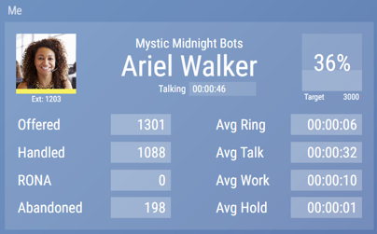
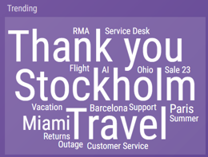
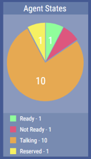
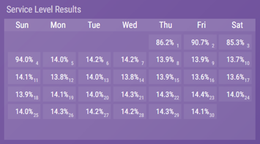
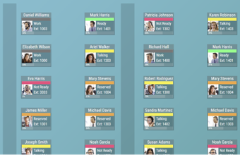
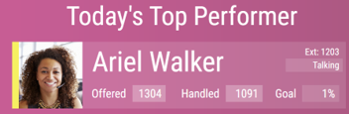
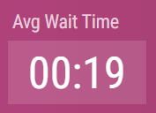
Widgets: Talking Heads / Floor Maps ..
Pie Charts, Timeline Charts, Word Cloud

Slide 23
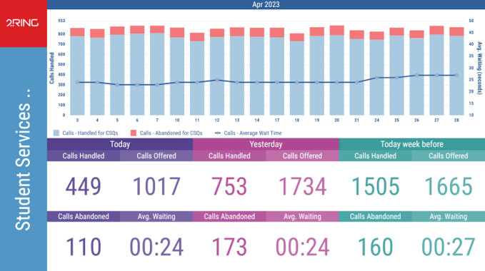
Historical Trending of Real Time Data ..
Calls in Queue Today vs Yesterday
Average Wait Time This Month
vs Last Month
Calendar Showing performance on each day of the month (if threshold for a team bonus was met that day)

Slide 24
Gamification: Highlight Personal Achievements ..
Values as Images can be used to deliver various gamification views
Custom User Attributes
and Personalized Layouts

Slide 25
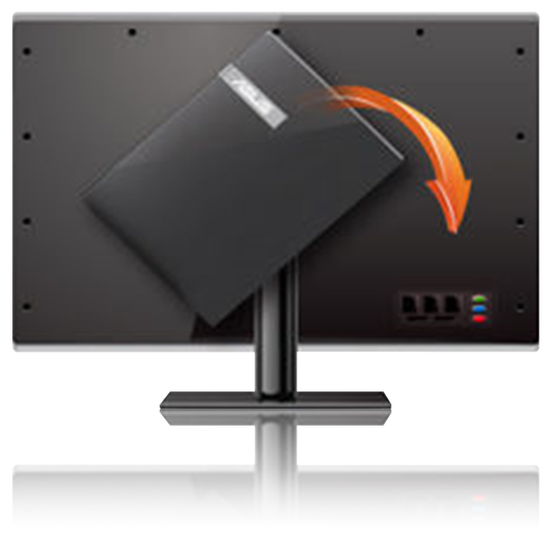
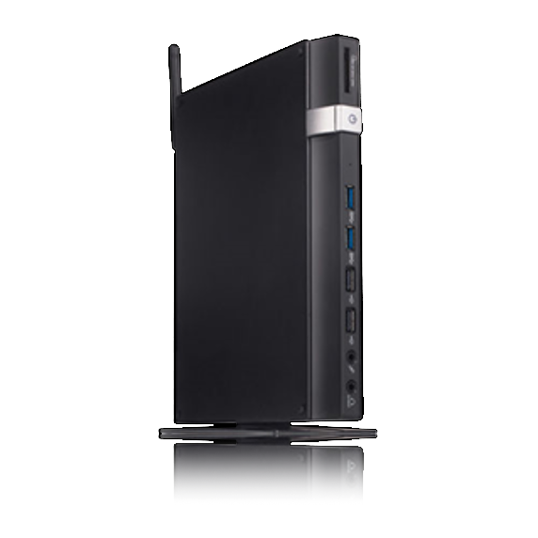
Hardware .. (not provided by 2Ring)
Screens
If you plan on using a smart TV, test it using www.2Ring.com/TryIt before purchase. E.g. Samsung has multiple different generations of smart TVs on the market, and older ones come with unsupported browsers.
PC / Mini-PC
Usually connected to a large screen via HDMI, VGA, or other cable.
Raspberry Pi
Enthusiasts can use Raspberry Pi. Reach out to us for tips.
PC Sticks
This is essentially a mini-PC which connects to the TV and has a browser running on it. There is no need to use TV remote control, you use your phone instead.
Digital Signage
2Ring also supports and integrates with AppSpace and Korbyt.

Slide 26
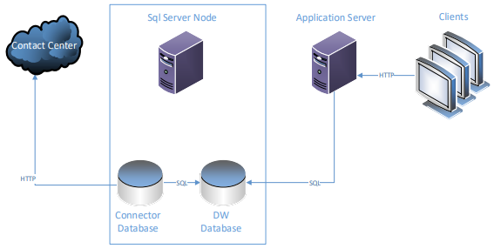
System Requirements (Self-Hosted Subscription)
OS Requirements
Windows Server 2022 (or 2019/2016)
SQL Server Requirements
SQL Server 2022 (or 2019/2017/2016)
Load Balancer
All multi-datacenter deployment models require a load balancer for web servers on the application servers.
Browsers Supported
Microsoft Edge
Mozilla Firefox
Google Chrome
Safari on MacOS and iOS
On iOS using a browser in incognito mode (private browsing) is not supported.
Full Sizing Guide:
2Ring.com/DW-Sizing

Slide 27
Recap, Business Case for 2Ring ..
Stay informed no matter where you are
(web-based layouts)
Provide real-time information even to users who are not part of it (permalinks)
Review all important information on one screen (multiple data source)
Provide agents with additional business relevant information (ERP / CRM Systems)
Break-down stats for different skill-groups, sites, .. (unlimited number of layouts)
Create special layout for your service desk (Ticketing System)
Show metrics that matter to your users
(out of the box + derived calculations)
Utilize the support for creation of CUSTOM calculations and merge data for multiple queues / skill groups into one row / KPI
Support competition among agents
Show trends – e.g. number of calls handled over the recent period (e.g. last 4 weeks); create Top10 or Bottom10 views
Deliver Alerts via Email or to IM clients
Microsoft Teams, Cisco Webex, Slack, Discord
Broadcast messages to a scrolling text marquee

Slide 28

2Ring Gadgets for Cisco Finesse
Available for UCCX / UCCE / PCCE / WebexCC Enterprise
On-Prem Customers: 2Ring keeps adding new features and will add support for the upcoming new Cisco on-prem releases, once available.
DW Finesse Connector Now Available
Skilling Audit Log
Button Sets
Customer Journey for Team Profiles
Message Broadcasts
Agent State Trace
Export UCCX Chat Transcripts
Brand New 2Ring Browser Extension
Multiple Notes per Interaction
Better Navigation
HA Cherry Picking
Robust Security

Slide 29
Contact Us ..

