Slide 1
How to Create a Personalized Wallboard and Support #HybridWork
2Ring Dashboards & Wallboards for Cisco Webex Contact Center (WxCC)
Ossamah Shabbir, CCIE # 26891, MBA
Pre-Sales Director at 2Ring @2RingCX
Session ID: VILCOL-1102

Slide 2

Cisco Webex Contact Center ..
How to Create a Personalized Wallboard
and Support #HybridWork
Presented by: Ossamah Shabbir, Pre-Sales Director
(oshabbir@2Ring.com)

Slide 3


About ..
2Ring
Founded in 2001
Over 20 years of experience in providing reliable add-ons to contact centers.
Among 1000 of fastest growing companies in Europe in 2020
Active customers in 60+ countries
100% Indirect Sales Strategy
Available via Cisco Global Price List
Ossamah Shabbir
15+ Years of Cisco Experience
Cisco Collaboration Consulting and Cisco CCIE# 26891
Now working with 2Ring customers on enhancing the agent / supervisor & customer experience via
2Ring Gadgets for Cisco Finesse
2Ring Dashboards & Wallboards

Slide 4

Sample Layouts are Available at 2Ring.com/TryItWXCC and 2Ring.com/TryItWXCCgrids

Slide 5
How 2Ring Enhances Cisco Contact Centers ..
Letting users make any layout truly their own, without involving your IT helpdesk ..
Notes:
2Ring Dashboards & Wallboards for Webex Contact Center provides tremendous added-value by letting users make any layout truly their own and create all layouts by themselves – without involving their IT helpdesk.

Slide 6
Your Content & Your Style ..
Use a background image or settle on a solid color
Drag & drop as many segments as needed, position and resize each to your liking
Pick colors, font types, & sizes
Filter, sort, and auto-page your grids
Include scrolling banners/tickers/marquees
Sequence segments or entire layouts
Combine multiple values into a single row (merge multiple queues into a single row)
Display external content such as current time, weather, videos, web pages or social media feeds ..
Notes:
For Filter, sort, and auto-page your grids: That includes lists of agents, queues, etc.
For Combine multiple values into a single row: Or you can also merge multiple queues into a single row

Slide 7
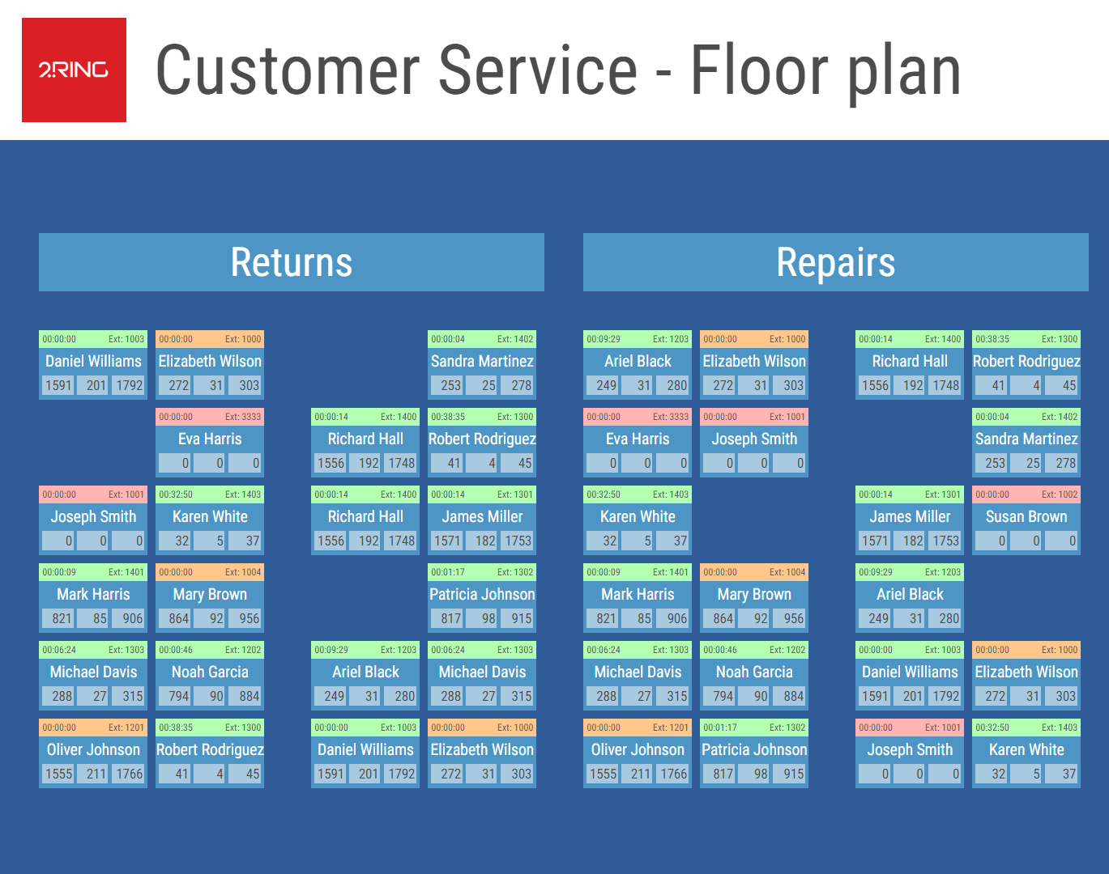
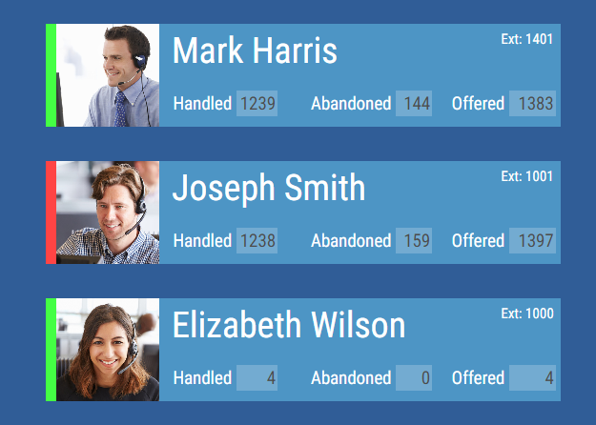
Widgets: Talking Heads / Floor Maps ..
Visualize data about
Agents
Queues
Tasks
Build a floor plan

Slide 8
Real-Time Thresholds & Alerts ..
Pick your metrics
Define your thresholds
Display alerts on your layout by
Changing color
Blinking
Playing a sound / recording
Deliver alerts via email or to IM Clients (Webex, MS Teams, Discord, Slack), and/or via SMS/texting*
Notes:
Mention that texting API from end user is required.

Slide 9
Business Units / Data Silos ..
Split users among multiple BUs (layout or data silos), so everyone can only see and/or change their own boards
Integrate 2Ring with Microsoft Azure AD for easy user management & access control

Slide 10
External Sources & Content ..
Illustrate data from multiple sources and content types at once:
Images
Videos
Web pages
PPT / PDFs
etc.
Notes:
You can display:
Marquees & Tickers
Weather Maps
YouTube Videos
Social Media Feeds
ServiceNOW Reports
Images/Pictures
Web Pages
You can also show the following data sources:
Cisco Webex CC (incl. Enterprise)
Amazon Connect
Five9
Genesys Cloud
Genesys Engage
Salesforce (Dashboard Elements)
ServiceNow (SNOW)
Staffino Customer Feedback
PowerPoint Slides – PDF
YouTube videos & streams
Weather – Current and Forecasts
SQL
Web Content incl. external reports - anonymous, iFrame

Slide 11
External Users ..
Make it easy for the corporate managers to see what’s happening in your contact center
Share your layouts with other BU administrators
Notes:
Provide real-time information on contact center performance, even to users who are not part of your contact center via permalinks

Slide 12
Multiple Data Sources at Once ..
Include additional business relevant information (ERP / CRM Systems)
ServiceNow
Salesforce
SQL
Build a special layout for each department – e.g. service desk: www.2Ring.com/TryItServiceNow

Slide 13
Broadcast Messages to a Scrolling Text Marquee ..
Send instant messages to a single board or to multiple boards at once
Display messages permanently or for
X number of minutes, or
Until a certain date/time

Slide 14
Support Competition Among Your Agents ..
Create Top 10 or Bottom 10 views
You can use our new Widgets too
Show trends – e.g. number of calls handled over the recent period
Share positive feedback received via 2Ring Staffino Feedback Service: www.2Ring.com/Staffino

Slide 15
2Ring Power Tool (Personalized Wallboard) ..
Personalized grids – create one layout and every agent sees his/her metrics only
Flexible window size with embedded layout auto-resizing to the space provided
Metrics can change colors and blink based on thresholds
Ability to be always visible on top of all other windows
Remembers its position on the screen and its own window size
Can be set to auto-launch once agent logins to her/his workstation
Can contain a team-based message ticker – scrolling marquee

Slide 16
Dashboards & Wallboards Layout Examples ..

Slide 17
Licensing & Platforms We Support ..
How to Consume 2Ring
2Ring Cloud Subscription
Self-host
2Ring Self-hosted Subscription
Perpetual Licenses
Supported Platforms
Cisco Webex Contact Center
UCCX – Express*
UCCE – Enterprise*
PCCE – Packaged*
* Self-Host Only

Slide 18
Live Demo ..
Questions? Interested in a live demo of 2Ring Dashboards & Wallboards?
See 2Ring in the Collaboration Village
Or request a private demo at
2Ring.com/Webex

