Slide 1
2Ring Gadgets for Cisco Finesse
Download Slides at www.2Ring.com/Calabrio

Slide 2
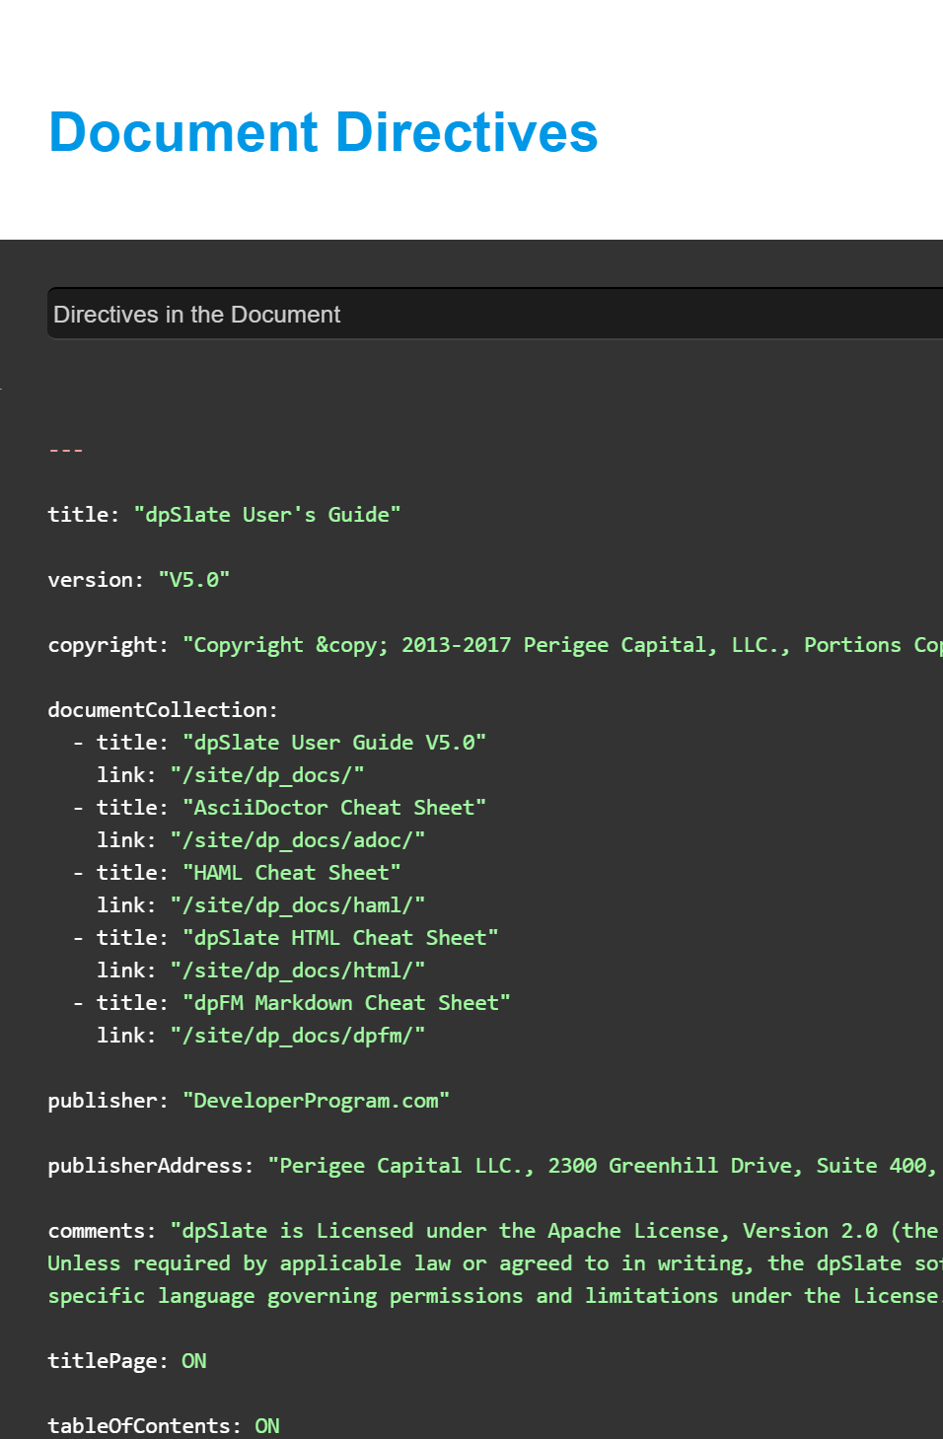
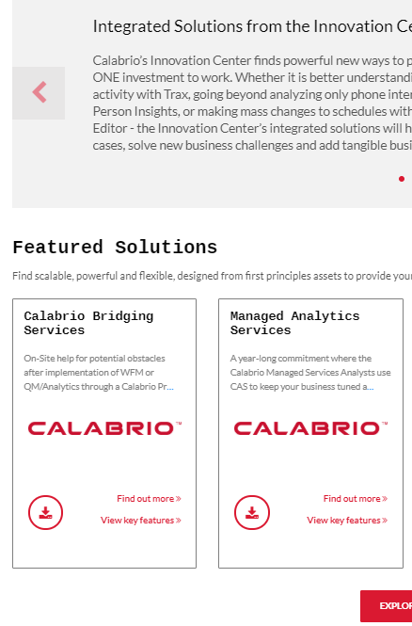

Calabrio Developer Program
Developer Platform
Calabrio Marketplace
Calabrio Support

Slide 3


About 2Ring
Founded in 2001
Global Presence / Global Customer Base
  European HQ in Slovakia
  North American HQ in Sacramento, CA
Among 1000 Europe’s Fastest Growing Companies by Statista (Financial Times)
ISV Partner with
  Amazon, Cisco, Five9, Genesys, Microsoft, ServiceNow
Indirect Sales Strategy
  Available on Cisco’s price list (CCW)
  Reseller Contracts with ConvergeOne, NTT, Presidio, WWT, and many more..

Slide 4
INTRODUCTION
2Ring GADGETS + CALABRIO
For Cisco
How do 2Ring Gadgets enhance Calabrio WFO and Call Recording?

Slide 5
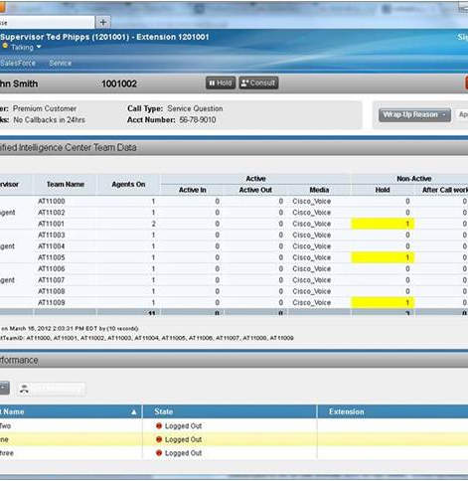
What is Cisco Finesse?
Next-generation agent and supervisor desktop
The main tool used by agents to handle all inbound and outbound interactions
100% web-based, nothing to install locally
Comes with basic gadgets / widgets / plugins
Comes with strong Finesse API that enables 3rd Party ISVs to improve agent/supervisor UX
Free with almost all CiscoCC platforms
  Cisco Contact Center Express – UCCX
  Cisco Contact Center Enterprise – UCCE
  Cisco Contact Center Packaged Enterprise – PCCE
  Cisco WebEx Contact Center Enterprise – UCCE hosted by Cisco in AWS
  Cisco WebEx Contact Center – a cloud-based offering for SMB that uses “Finesse Like” desktop. It is NOT Cisco Finesse.

Slide 6
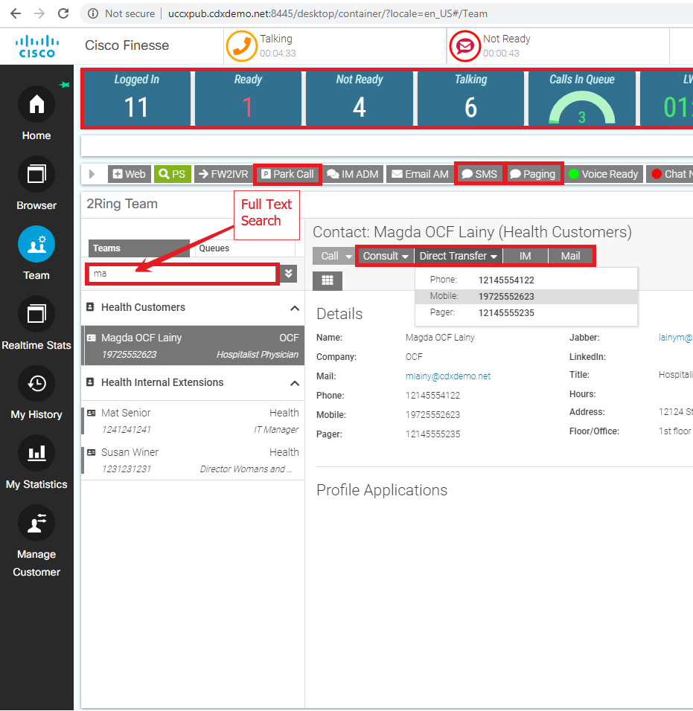
2Ring Gadgets for Cisco Finesse .. Intro
Cisco Finesse + 2Ring Gadgets
  Peanut Butter & Jelly Combo
  iPhone + AppStore
A Single Pane of Glass
  Showing all the necessary information in one place
    Customers | Teams | Queues | Agents | BackOffice Contacts
  Providing all the necessary alerts and notifications
    Calls in Queue, RONA Alerts, ..
  Integrating with CRM & ServiceDesk Systems
Platform Requirements
  Cisco Finesse 10.6+ on
    Cisco UCC Express (UCCX)
    Cisco UCC Enterprise (UCCE) – incl. Packaged and Hosted
    Cisco WebEx Contact Center – Enterprise Cloud
    Cisco WebEx Contact Center – SMB Cloud*
  Calabrio One 10.4+ on-premise
  Calabrio ONE Cloud
  *Not Yet Supported, Cisco API is not yet public

Slide 7
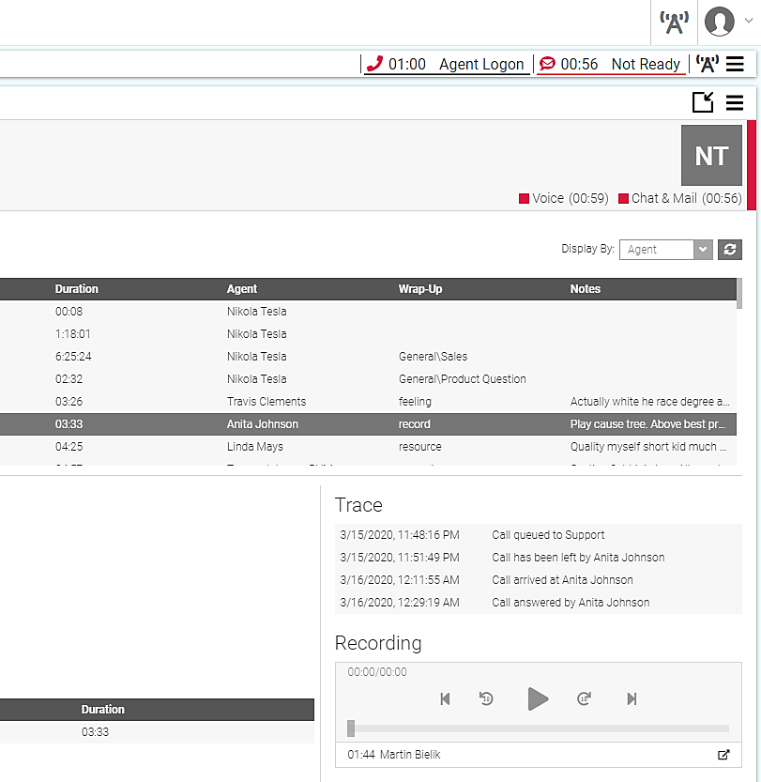
2Ring Gadgets .. Availability of Call Recordings
Added to Cisco Finesse via Call/Chat/Email History in 2Ring Gadgets
  Browse & Search history of customer interactions by
    Agent
    Contact/Customer,
    Phone #, or by
    Email Address
  Search & Play Audio Recordings directly in Cisco Finesse via 2Ring Gadgets
  Deep link to Calabrio Quality Management for Transcriptions/Screen Recording/Score cards, etc.
Added to Customer’s CRM System(s)
  Push Call Information (including links to Calabrio Call Recording) to the interaction history in the integrated CRM or Service Desk system
  Deep link to Calabrio Quality Management for Transcriptions/Screen Recording/Score cards, etc.

Slide 8
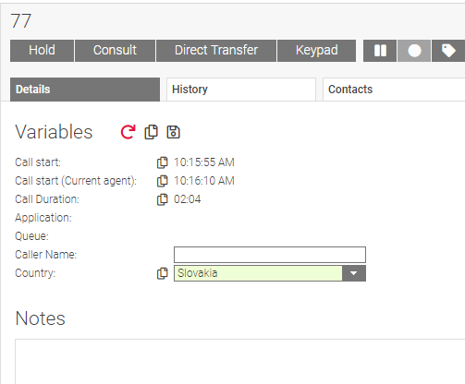
2Ring Gadgets .. Call Recording Automation
Manual Pause / Resume Call and Screen Recording
  Pause/Resume for unified Audio/Screen at the same time
Request a Call Review while still on a call
Tag Calls / Send Customer and Interaction Metadata to Calabrio ONE
  Automatic – 2Ring Orchestrator / Workflow
  Manual – CallVar Editor or Tag Buttons

Slide 9
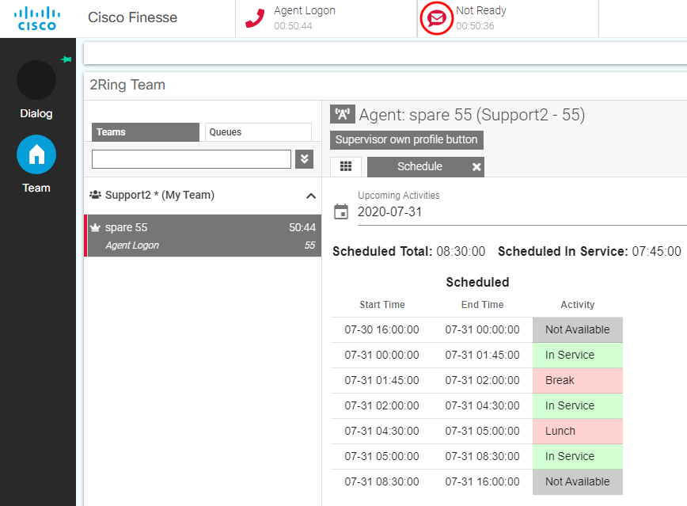
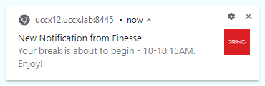
2Ring Gadgets + Calabrio WFM .. for Agents
View Agent WFM Schedule
  Today or use a date picker to view schedule for any other past or future date
Receive WFM Schedule Alerts
  A toast displayed on top of all windows
    “Your 30-min break starts at 11AM.”
    “Your scheduled break window has started.”
Submit Requests for a
  PTO
  Shift Swap
Auto-Report Agent Login/State to WFM
  Sending login/logout requests to Calabrio for Hoteling / Hotdesking users (adds support for UCCE Free Seating)

Slide 10
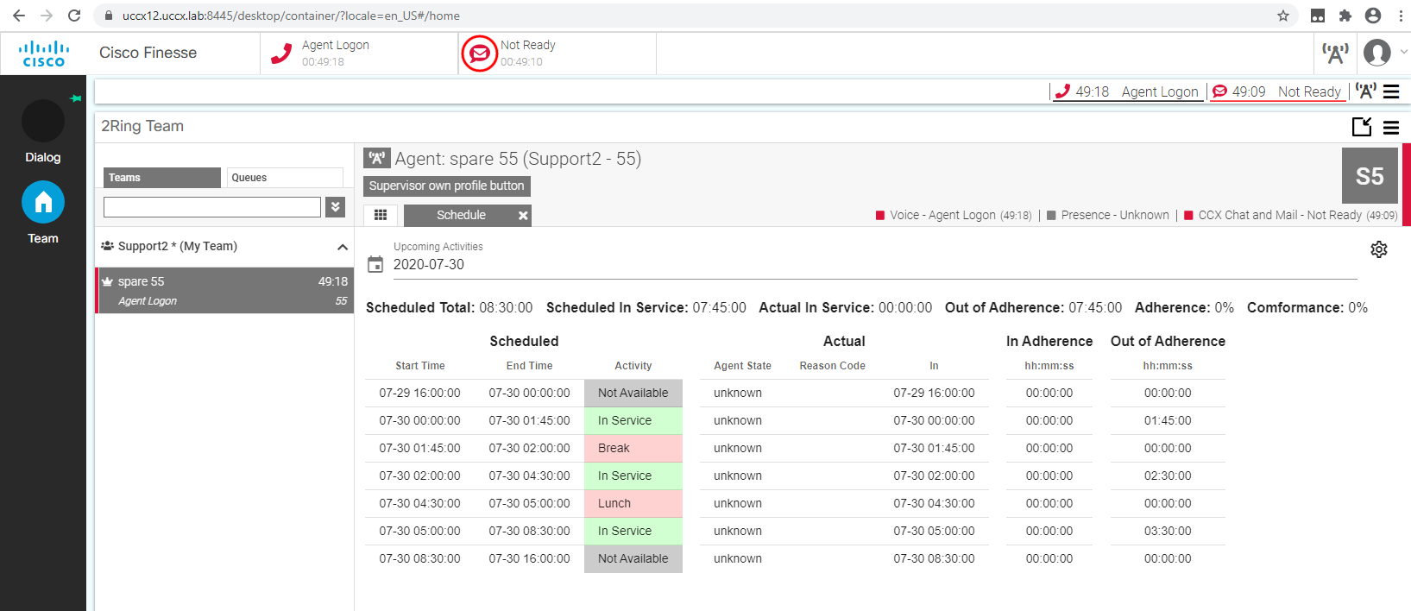
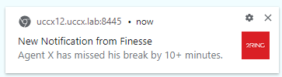
2Ring Gadgets + Calabrio WFM .. for Supervisors
View Agent’s WFM Schedules
  Supervisor can access and view schedules of agents belonging to his/her call center teams
Keep an Eye on Realtime Adherence (RTA)
  Compare Schedule vs Reality
Receive Schedule Alerts
  A toast displayed on top of all windows
Let 2Ring Workflow Change Agent’s State
  E.g. Make agents go “NotReady – Break” after interaction when scheduled for “Break”

Slide 11

We are not Done .. Features Considered
2Ring Dashboards & Wallboards – add Calabrio Connector to display
  Word Cloud built using Calabrio Speech Analytics
  Individual Adherence / Conformance / Occupancy and Utilization Agent Statistics
2Ring Team Gadget
  Display Agent Quality Scores with trends
  Display Team Average Quality Score
2Ring Team Gadget - Interaction History
  Show Speech Energy + Speech Analytics overall score
  Let agent Tag a Call for review right there
  Link to Calabrio Post Call Survey Data
  A link to Quality Review Form if filled out by the supervisor + provide agent with alert in real-time
Push More Calabrio data to CRM / ServiceDesk
  Calabrio PostCallSurvey
  Calabrio Transcripts

Slide 12
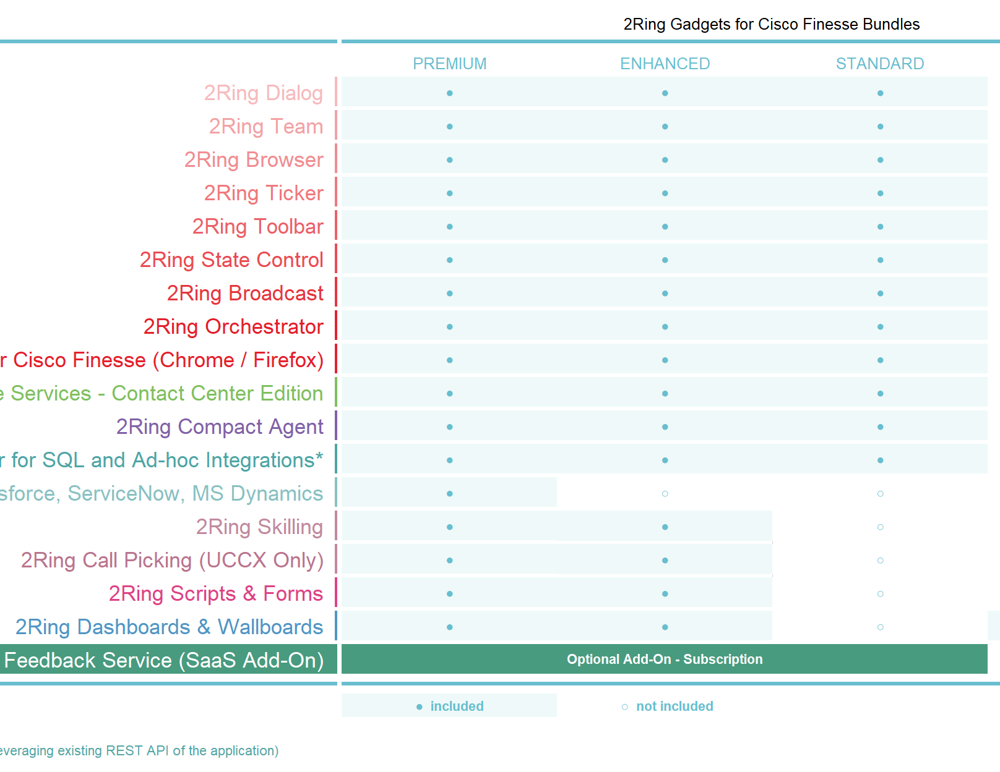
2Ring .. How to Purchase
Offered in Three Bundles
  Calabrio integrations are part of all 2Ring bundles
Available from
  Calabrio Marketplace
  Cisco CCW
  Cisco / 2Ring / Calabrio Resellers
  2Ring does NO direct sales
Pricing
  Perpetual Licensing*
  On-Premise Deployment
  Min. order size – 10 seats (peak number of concurrently logged in agents + supervisors)
*Subscriptions based pricing is at works and will be added in 2nd half of 2020

Slide 13
Before you go… ☺
2Ring & Calabrio provide an Enhancement to Cisco Finesse for Agent/Supervisor to include Calabrio WFO interaction for ease of use
Both 2 Ring & Calabrio have longstanding development relationships within the Cisco Contact Center community with brand awareness among partner community/Cisco alike
Can Jointly Rely On an Established Joint Customer Base

Slide 14
SCHEDULE A DEMO
2Ring GADGETS + CALABRIO
Contact:
Michal Grebac, 916-514-3355
mgrebac@2Ring.com

Slide 15
THANK YOU!

