Slide 1
2Ring Update .. UCCX
Presented by: Michal Grebac
Cell: 916-514-3355
Email / WebEx Teams: MGrebac@2Ring.com

Slide 2
Agenda
Solutions Plus Update
Gadgets – New Features / Common Use Cases
Dashboards & Wallboards – What’s New
Staffino Feedback Service

Slide 3
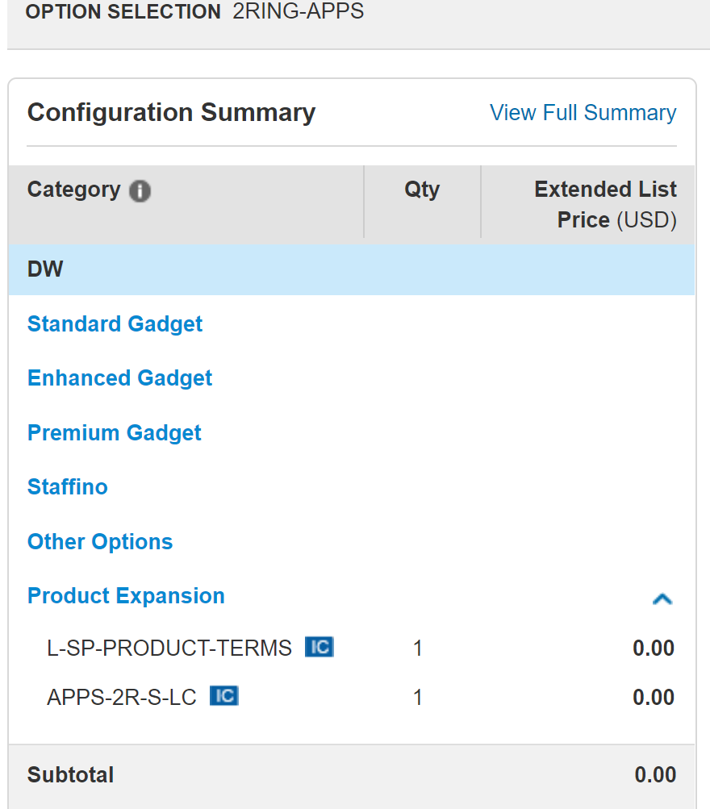
More
2Ring SKUs
Available
via S+
(search for 2RING
in CCW)
Notes:
Cisco added:
3Y and 5Y support options
Standard Bundle
Staffino Feedback Service “Subscription” options

Slide 4
2Ring Gadgets for
Cisco Finesse v4.2
2Ring.com/Gadgets
2Ring.com/WebEx
Notes:
All this works with UCCX 11.6, so customers can get these features even before they upgrade to UCCX12.
If support for chat/email channels is not needed, UCCX 10.5/11.x is supported.

Slide 5

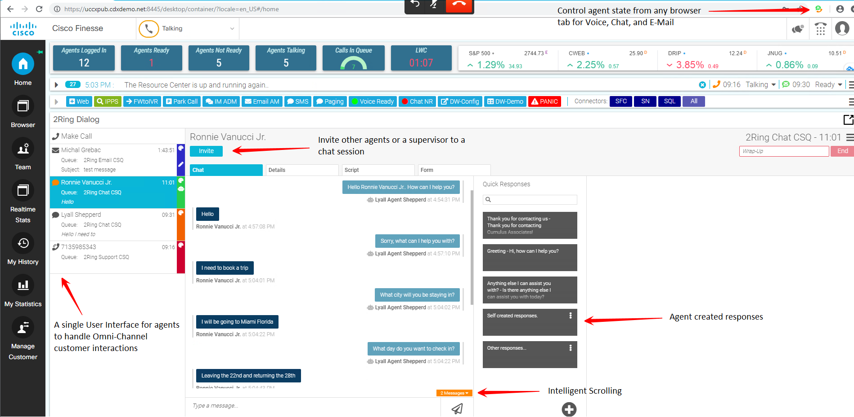
Built on Top of Cisco Social Miner

Slide 6
Call Control / Chat / Email Enhancements
Handle Voice, Chat, Email, Texting (WebText, Tropo, ..) in one gadget
Add Custom Buttons / Remove Buttons (e.g. remove blind transfers, medical script, ..)
Tie Additional Actions to Buttons (e.g. tag all transfers)
New Call / Chat / Email Alerts + New Response Alerts
Identify Customers using multiple CRM data sources
Push transcripts/emails to CRM
Typing Indicator / Auto-Colored Conversations (queue, priority)
Unread Responses are Clearly Visible in the List
Unread Content Auto-Paging Scrolling
Response Templates for Chat & Email – one click paste, searchable, personal/team, use multiple, placeholders, ..
BOT integrations / BOT involvement indicator
Workflow Actions based on responses (profanity)
Group Chats – logging system events – see invited participants + support for private chat among agents, after chat conversation to wrap up the interaction
Supervisor Barge-in + Whisper for Chat

Slide 7
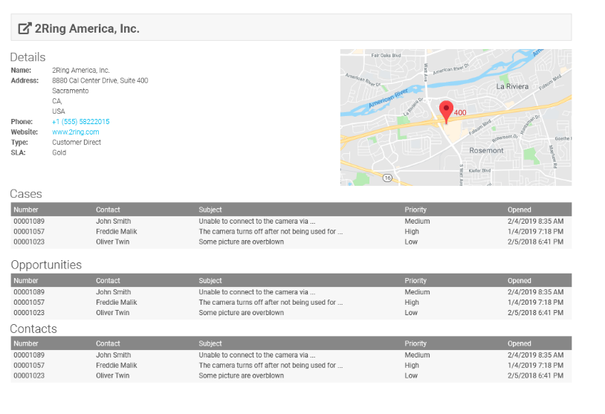
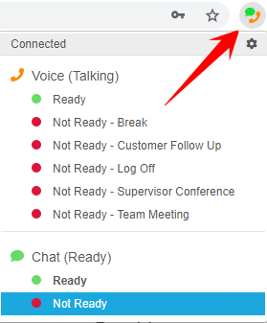
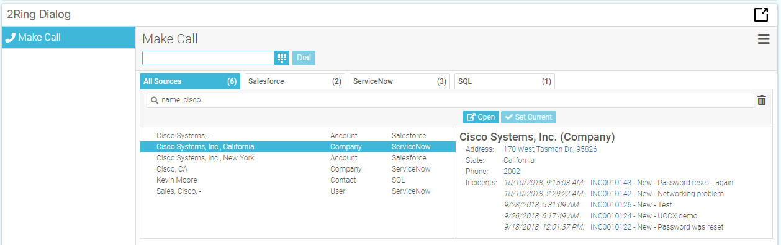
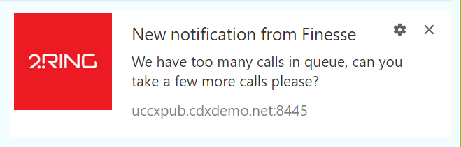
Integrations for Omnichannel
Integrations with Multiple Systems
ServiceNow
Salesforce
MS CRM Dynamics
SAP
SugarCRM
Any SQL based applications
Toast Alerts (on top of all the windows)
Advanced CLID
Trigger 2Ring Orchestrator to perform an action or set of actions
Browser Extension for Chrome / Firefox
Agent State change
Agent State visible outside of Finesse
ľ

Slide 8
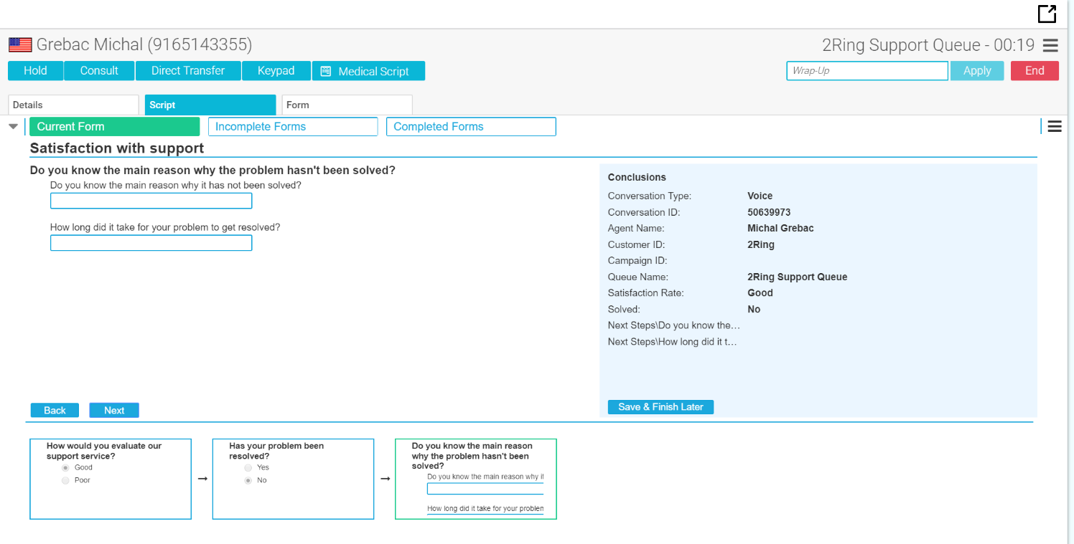
Guiding Scripts with Automation
Scripts & Forms inside
of 2Ring Dialog Gadget
Linked to each interactions
Next and Finish buttons
can perform actions
  Call triaging and transfer – e.g. gather intake information and e-mail intake specialist or attorney
Data can be logged to a SQL DB & emailed

Slide 9
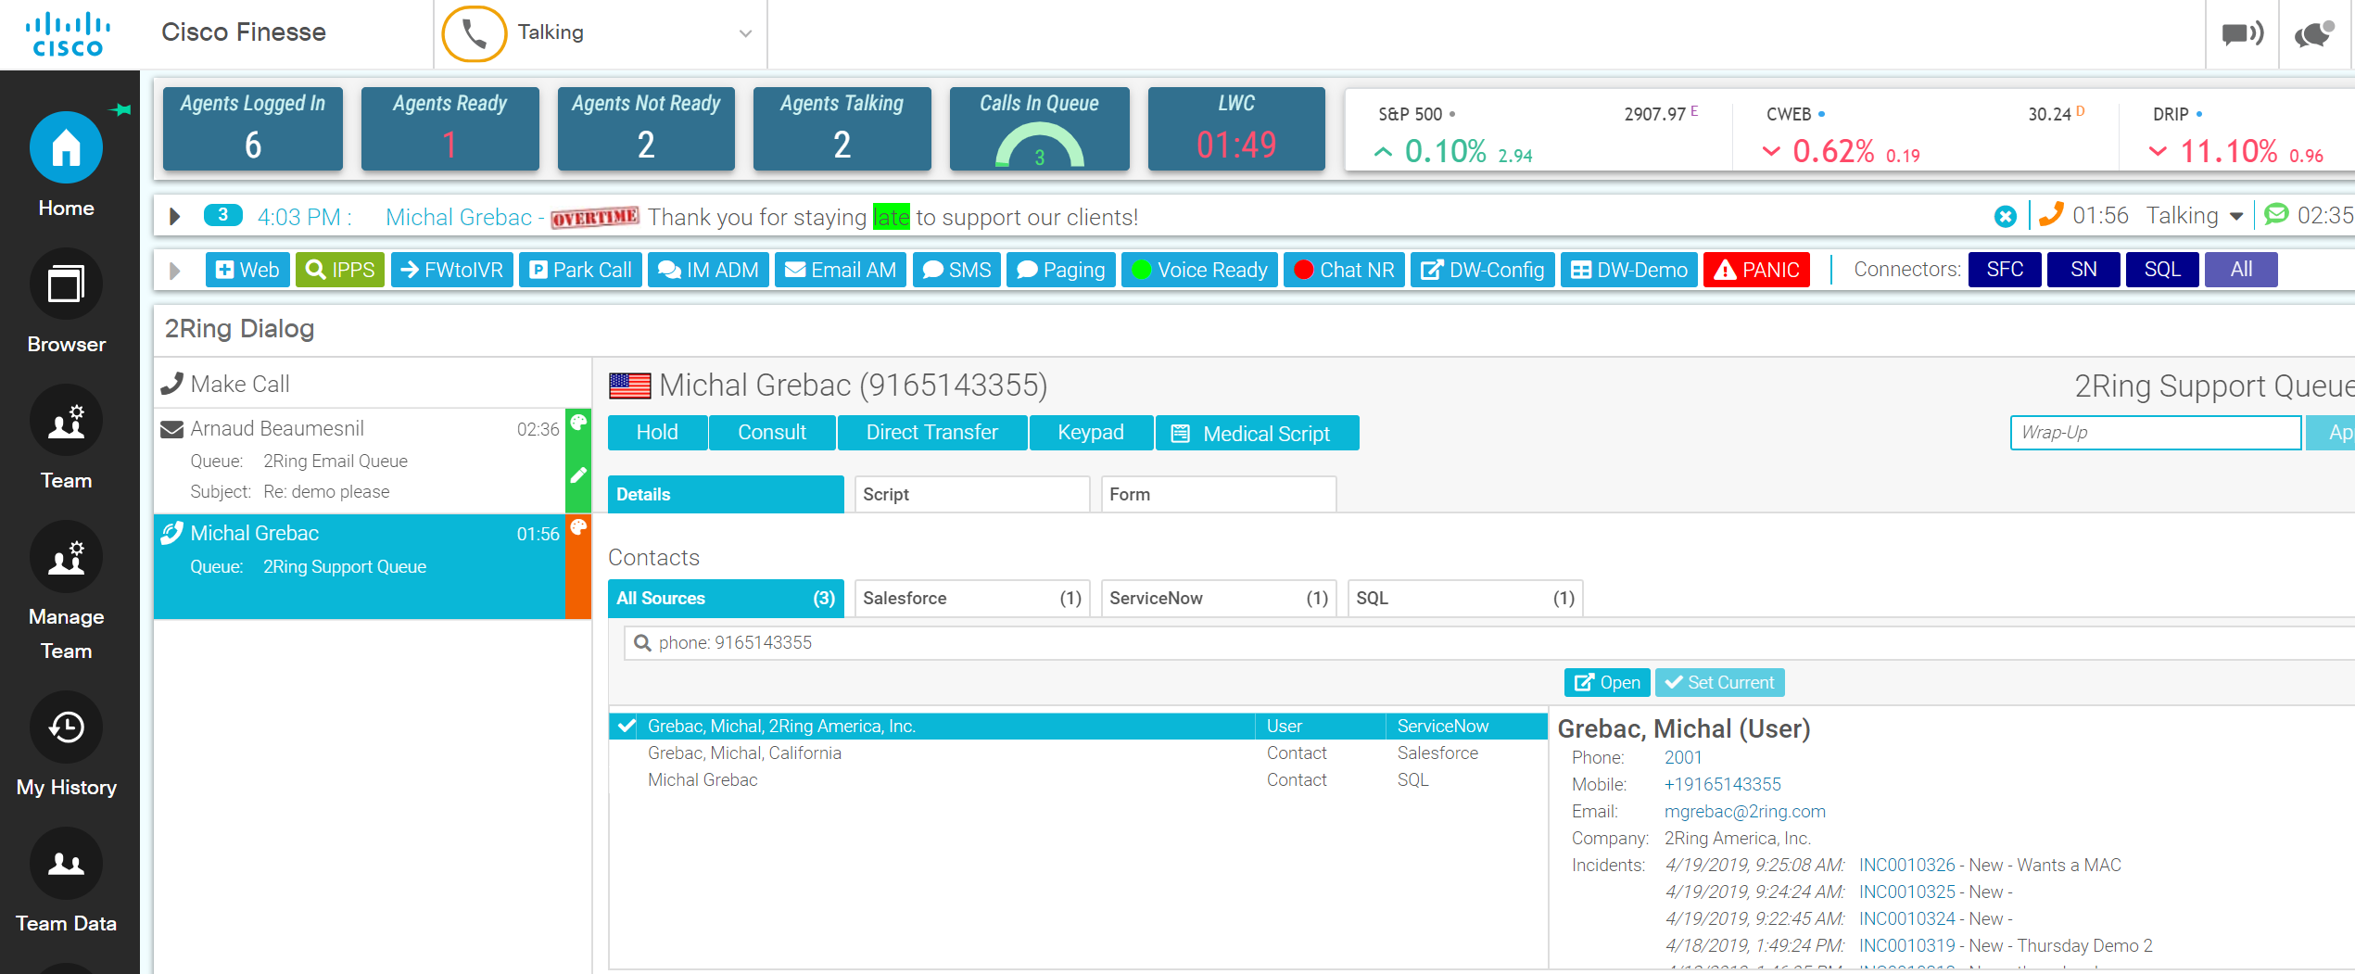
Contacts / Address Books

Slide 10
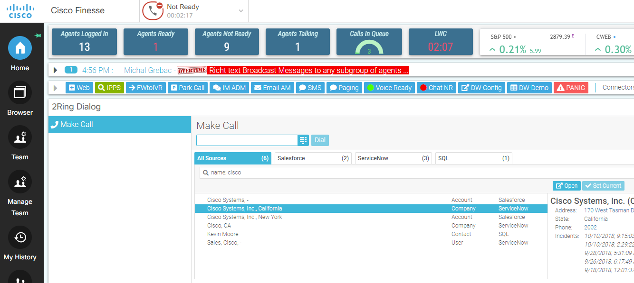
Contact Management (Attendant Console)
Generic SQL Connector – “no limits” & used for CallerID
Finesse supports a total of 50,000 contacts. The total number of contacts per agent across all phone books is limited to 1,500.
Auto-Sync Contacts from CUCM, MS AD, SQL, csv, Exchange, Lotus Notes
Manage Contacts Manually – No Admin Access Necessary
View Previously Submitted Forms/Scripts via 2Ring S&F
Additional Action Buttons
  View Address on a Map
  Send a Text
  Call Related Actions
Speed-Dial Buttons
Auto-Generated from Contacts in Address-Books
Default + Additional Actions
Integration with CUPS presence
Drag & Drop Conference Setup

Slide 11
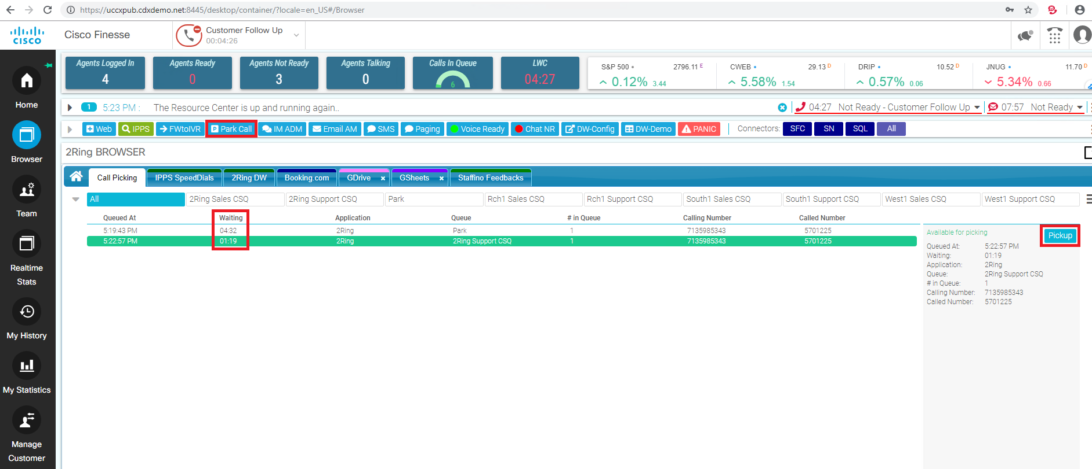
UCCX Call Picking / Parking (Attendant Console)
Agent can Park & Pick Calls
  Auto-store AgentID/Name to a CallVariable on Park
Configure what information about calls in queue is displayed to agents
  Calling number
  CallVariables
Notify about a New Call in an urgent queue => agent receives a toast alert, s/he can park the current call and picks the urgent call with one click

Slide 12
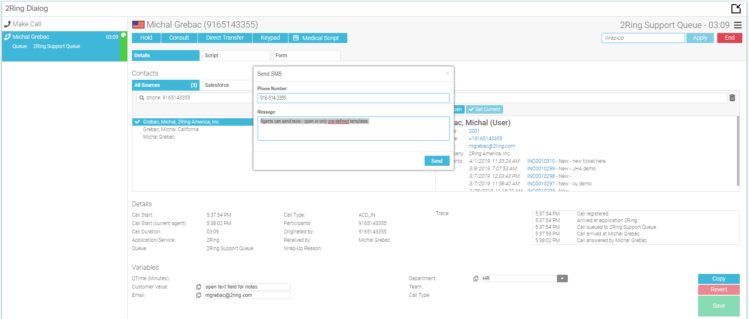
Configurable Buttons / Forms
ToolBar
Texting Integration (WebText, ..)
Paging Integration (NotePage)
Call Recording Integration (Calabrio, ..)
Request Form (replacing SharePoint Forms) – stored to SQL + emailed where needed
Panic Button Form
Extending Wrap-Up if no Wrap-up Code Selected
  Manual Outbound Calls
  CallVar Editor – additional wrap-up fields incl. open text fields used for call tagging

Slide 13
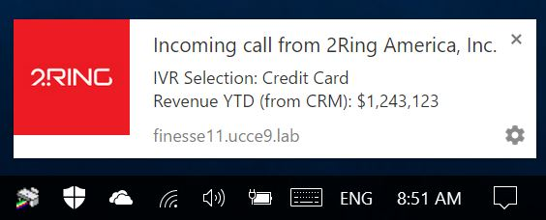
Toast Alerts vs Pop-Over Notifications
Call / Chat / Email Alerts
  Caller ID + IVR related Alerts
  Long Wait
  IVR selection
  Different pictures/Icons based on interaction’s attributes
State Based Alerts
  RONA to Agent (visible until agent changes his state)
  RONA to Supervisor (immediate or only if agent stays in RONA for over selected threshold)
Multi-Condition Alerts
  Wallboard Metrics
  (LWT + # of calls in Queue)
    Alert 1: Agents Talking
    Alert 2: Agents in NotReady Reason Codes XYZ
    Alert 3: Supervisors
Notes:
Alerts & Notifications on Top of All the Application Windows

Slide 14
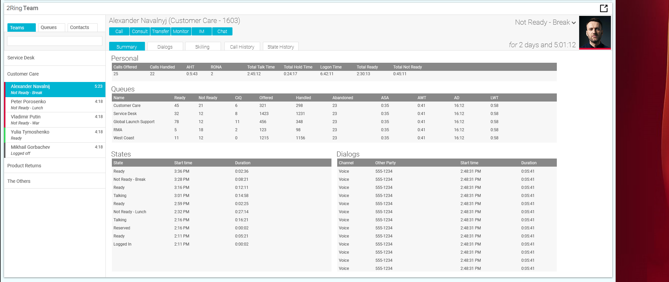
Supervisor’s Single Pane of Glass

Slide 15
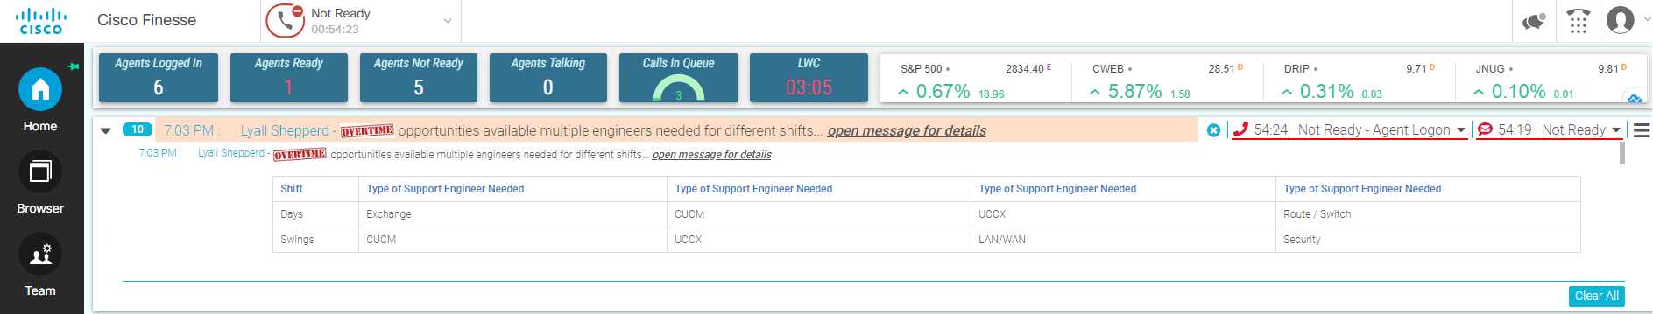
Rich Text Broadcasts / Chat
Rich Text Broadcast Messages with
Images
Blinking
Bold, Underline, Italics
Insert URL
Bullets
Numbers
Grids
Supervisors Sending Messages
To any group or subgroup of agents (teams, queues, skillgroups)
Picked agents one by one
Banner(s) used in 2Ring Wallboard layouts
Integrated Chat
No login necessary
Whitelists/blacklists
Chat transcripts in SQL (optional) with OoB report
ľ

Slide 16
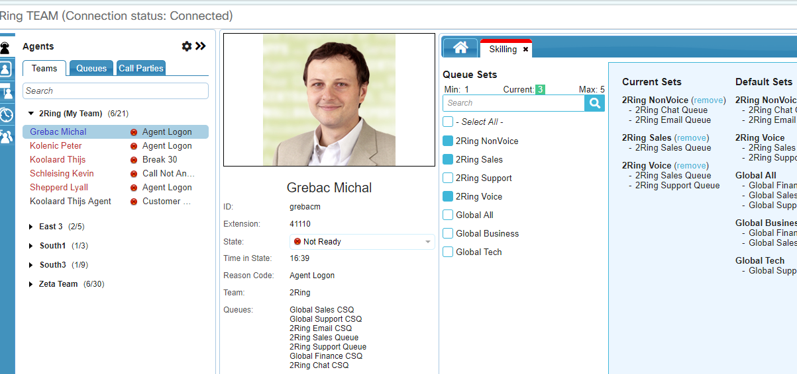
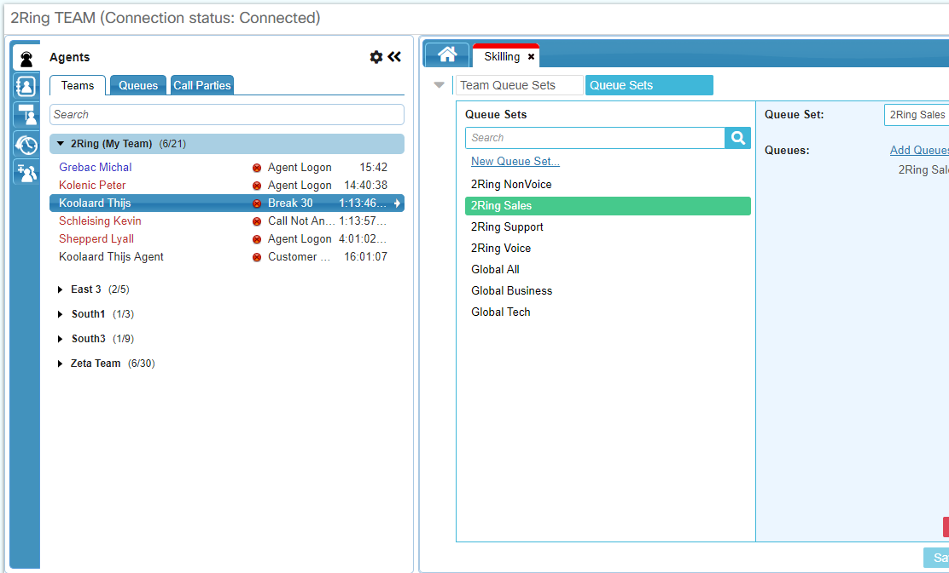
Self-Skilling for Agents (in Team Gadget)
Reskilling in Finesse using “Queue Sets”
Supervisors - Single Click to re-skill an agent
Agents – self-skilling (Optional)
Audit Report (CUIC)
Limits (min/max number of “queue sets”)
Platform Support (UCCX 10.6 and above)
UCCX | Resource Skill
UCCX | Resource Group – PARTIAL SUPPORT – CSQs that use Resource Group mode cannot be managed via 2Ring Skilling; However, customer can still create CSQ that use resource skill and add agents to those CSQs (or remove from) via 2Ring Skilling Tool
UCCE | Precision Skilling
UCCE | Skillgroup based Skilling

Slide 17
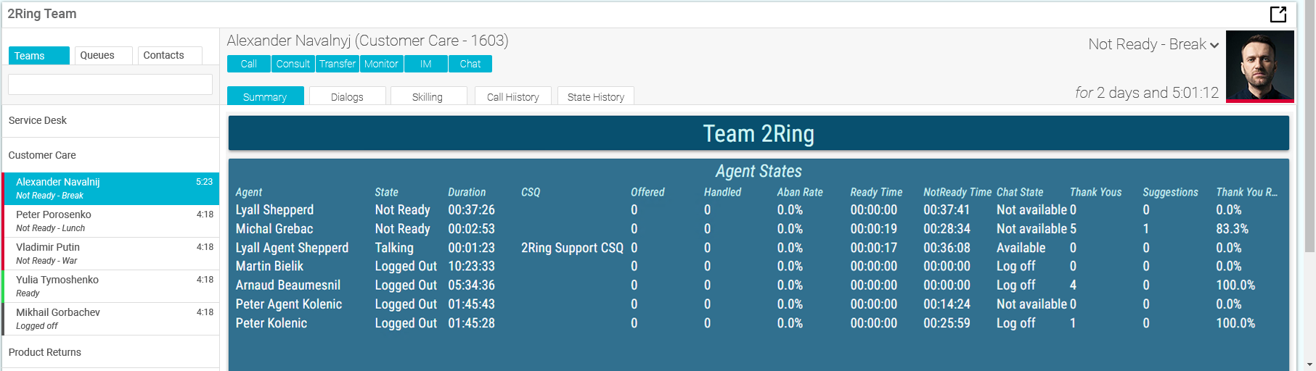
Team Gadget – Detail Info from Wallboards
Team & Queue Based Stats
Over 250 different KPIs / Metrics
Grids with over 48 different KPIs / Metrics
Real-time CSAT, NPS, or CES with Staffino integration
ľ

Slide 18
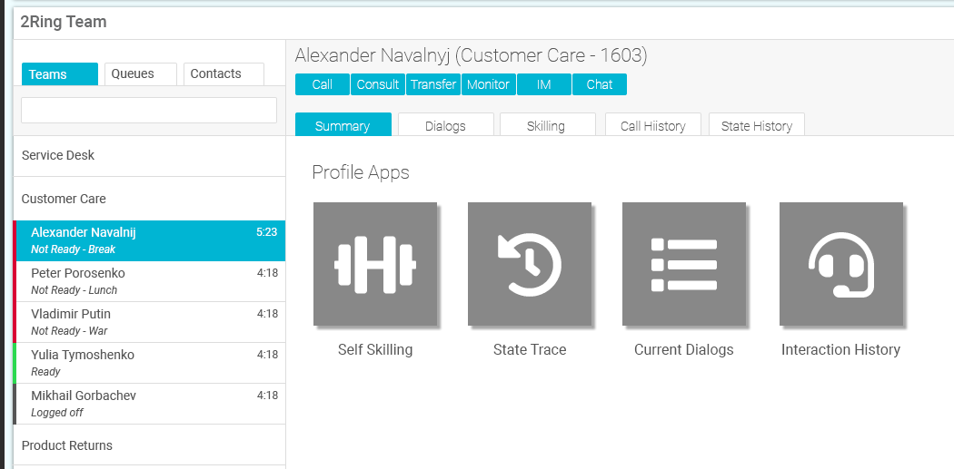
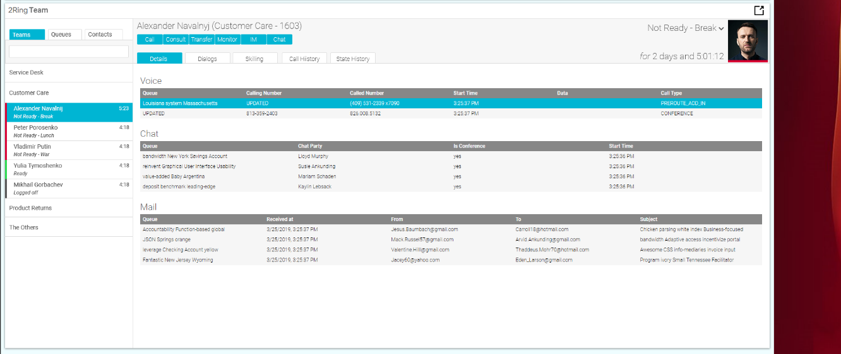
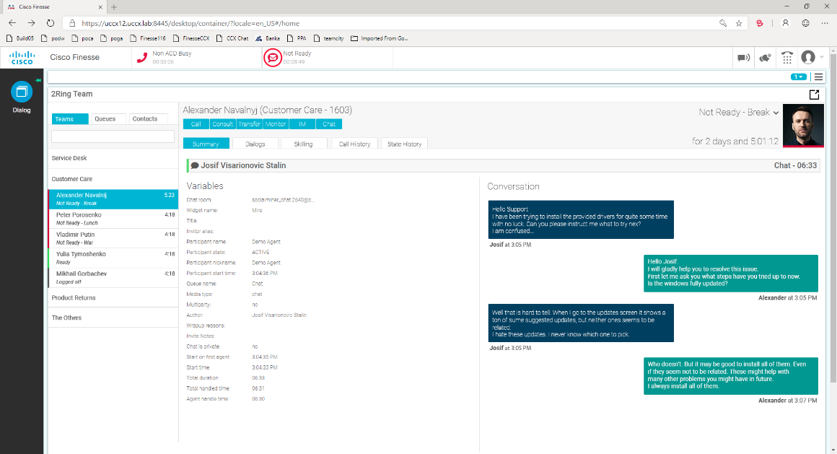
Team Gadget – Profile Apps
Profile Apps
State History Across All Channels
  Grouped by State
  Grouped by Date
  Grouped by State & Reason Code
  Historical Data – default 8 weeks
Call History
  Click2dial
  Historical Data – default 30 days
Current Call / Chat / Email in Realtime
  Visible to agents & supervisors including call trace
Staffino Feedback Service info

Slide 19
2Ring Dashboards
& Wallboards ..
2Ring.com/DW
2Ring.com/DWTrial
2Ring.com/TryIt

Slide 20
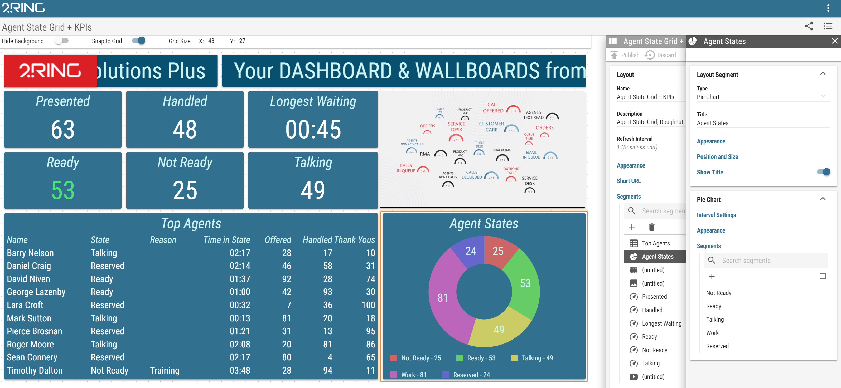
Dashboards & Wallboards v7 means a Brand-New Configuration Tool

Slide 21
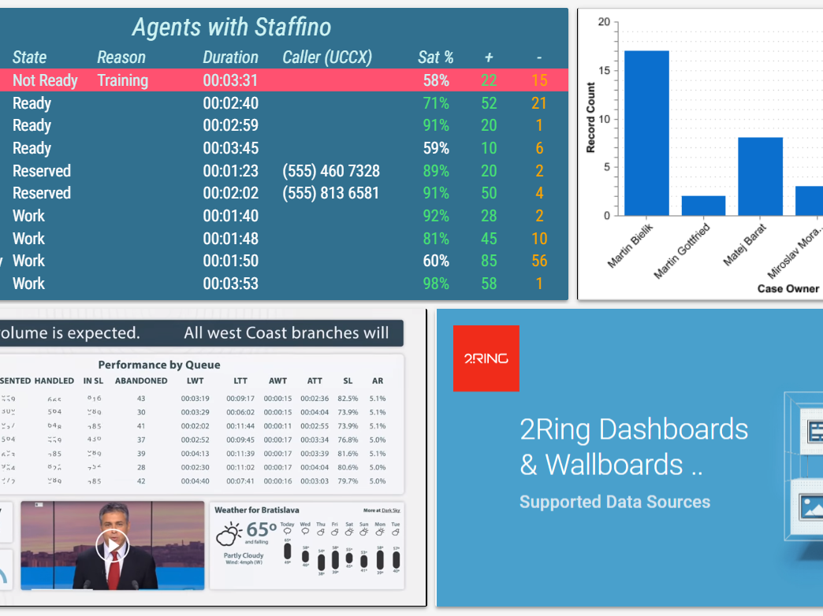
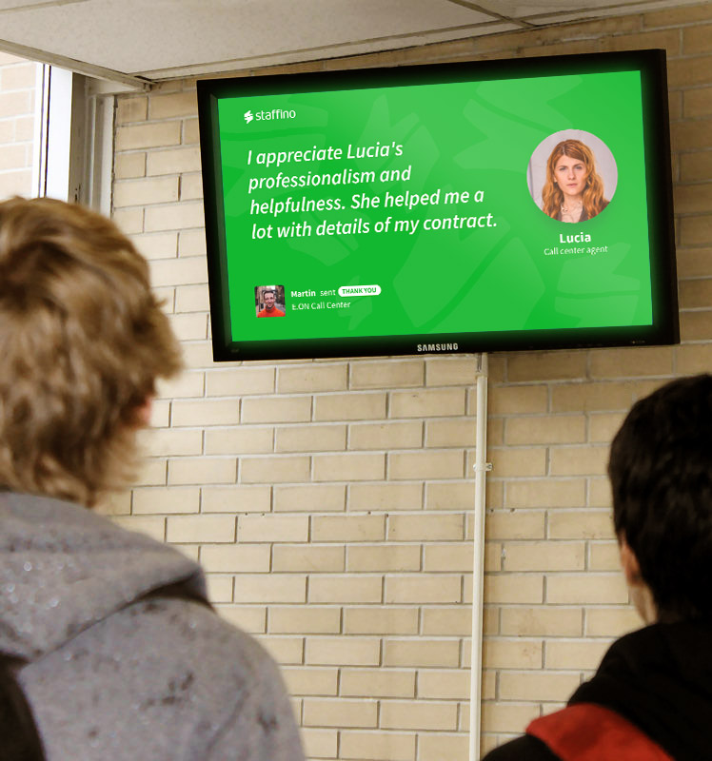
New Connectors / Data Sources
UpstreamWorks
ServiceNow
Salesforce
Staffino
Facebook Feed
Twitter Feed
..

Slide 22
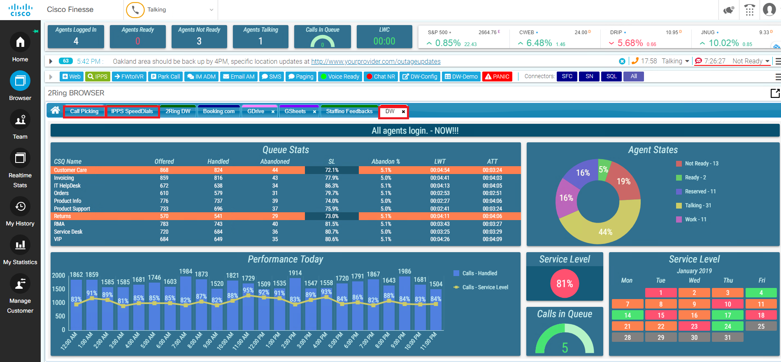
Gadgets – Enhanced Bundle ..
2Ring DW is Best with Finesse

Slide 23







2Ring Staffino
Feedback Service ..

Slide 24
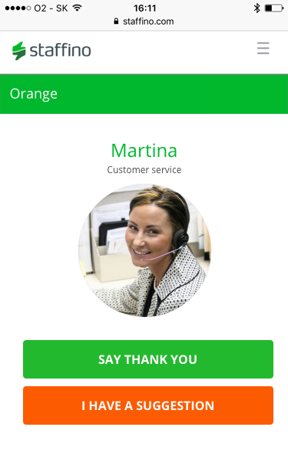
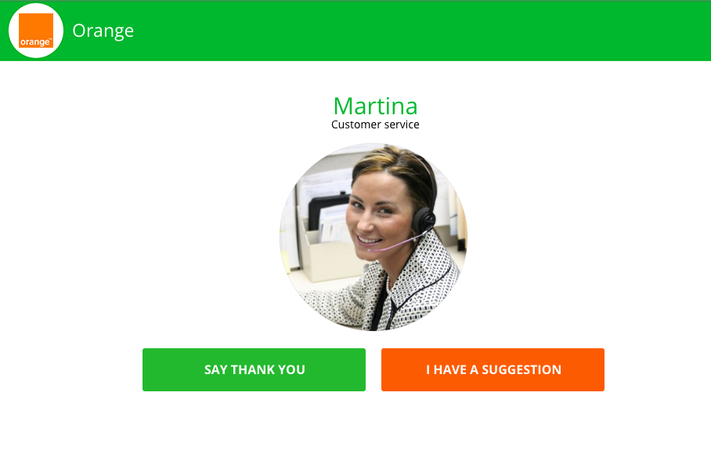
SAY THANK YOU or I HAVE A SUGGESTION

Slide 25



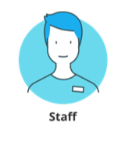
2Ring Staffino Feedback Service ..
Negative feedback is only sent to the agent’s supervisor ..
Positive feedback
Managers can respond to customers right away!
Positive feedback can be sent
to agents in real-time, as a daily
report, or displayed on
2Ring Dashboards & Wallboards ..
It is up to managers
to uncover negative feedback to agents ..
Staff and
managers
can discuss
each feedback
and improve
processes ..

Slide 26
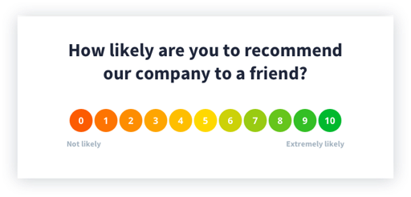
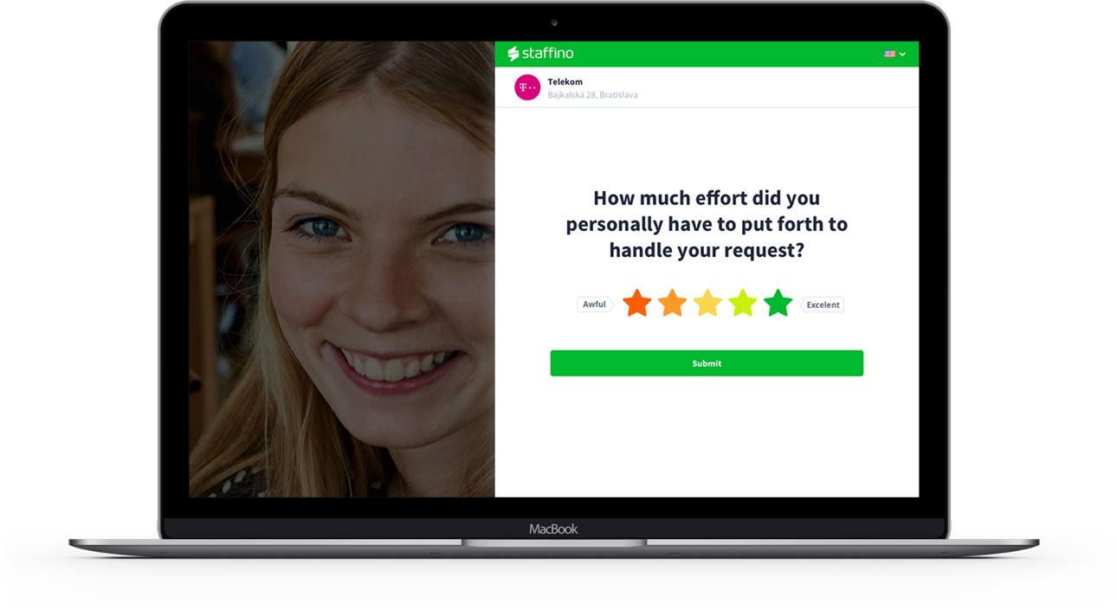
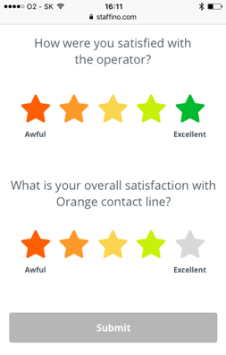
Many Forms of Feedback
NPS (Net Promoter Score)
- a Brand Survey that can
be used on a one-time or regular basis. It assesses
the loyalty of customer relationships to the company/brand.
CSAT - accurate trend measurement and CX evaluation on a transactional level.
The customer leaves a thank-you or a suggestion and then is asked additional questions using 5-star metric.
Customer Effort Score (CES) - measure how much effort a customer had to put into a certain interaction

